Slide 1
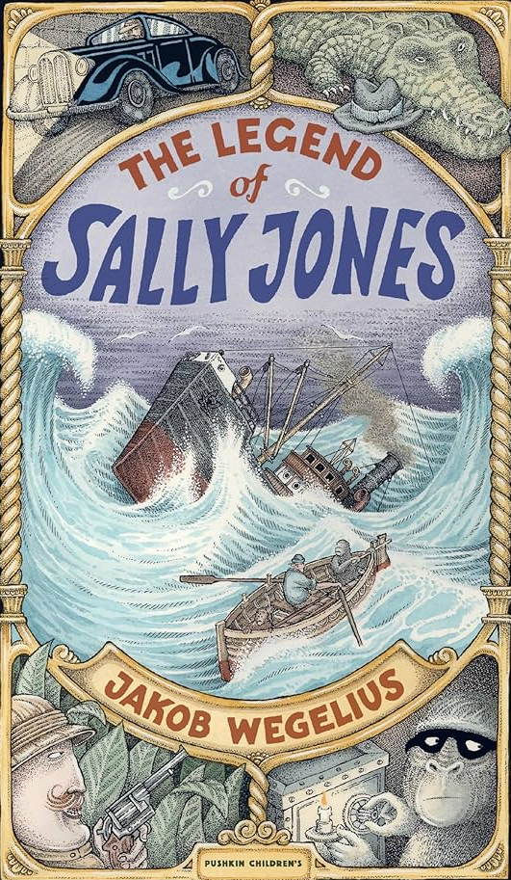
Take one Artsist
Owls Class
As a Writer
I can form a descriptive paragraph
I can use the present perfect tense
I can use drama to plan my ideas
I can use speech marks and punctuation
I can convert adjectives into adverbs
I can use emotive vocabulary in an advert
I can choose vocabulary that describes the emotion
I can use verbs to be persuasive
I can organise writing into simple paragraph like sections
I can use ‘a’ and ‘an’ before a noun
I can plan sequencing adverbials
I can publish writing
As a Mathematician
I can identify a whole and the parts that make it up
plain why a part can only be defined when in relation to a whole
I can explain the size of the part in relation to the whole
I can explain how a quantity is made up of whole numbers and a fractional part is composed
I can accurately label a range of number lines and explain the meaning of each part
I can compare and order mixed numbers when the whole number is the same
I can make efficient choices about the order they solve an addition problem in
I can express and convert a quantity from an improper fraction to a mixed number
I can subtract a proper fraction from a mixed number (converting to an improper fraction first)
As a Scientist
I can understand why solids and liquids behave differently by looking at a simple explanation of how molecules are arranged in each
I can discuss the scientific phenomena and what this tells us about gases
I can use a data logger to record the temperature before and after
I can draw up a table to record the results of their investigation
I can present findings from their fair test to discover the factors that speed up evaporation

Slide 2
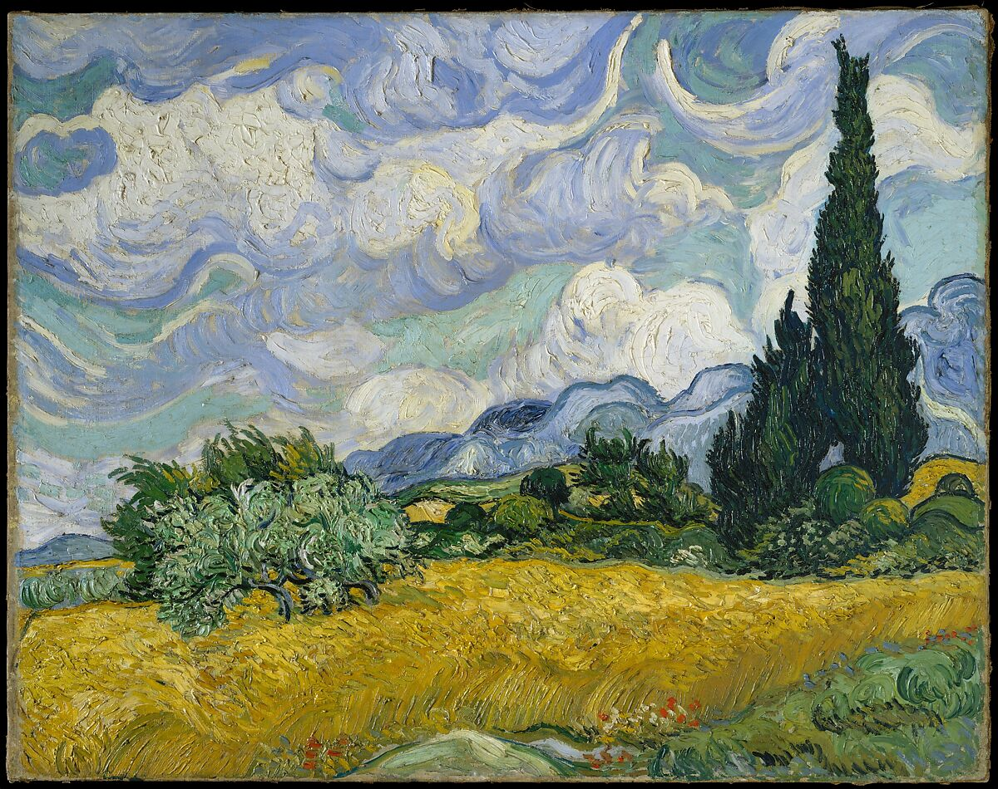
As a computational thinker
I can list an everyday task as a set of instructions including repetition
I can modify loops to produce a given outcome
I can choose which action will be repeated for each object
I can identify which parts of a loop can be changed
I can evaluate the use of repetition in a project
As a religious explorer
I can explain how God created the world
I can suggest what is wonderful in the world to me
I can make links into how Christians are inspired by God
I can suggest how people can show and follow God’s examples
As an Artist
I can create observational drawings
I can translate the movement of clouds through drawings
I can form opinions and observations of an artist's work
I can learn a new art skill of using chalk
I can explore the medium of chalk with paints and water
I can present my final piece using the skills I have learned
As an athlete
I can perform a variety of movements with good body tension
I can repeat longer sequences with clear shaped and body movement
I can perform a range of skills with some control and consistency
I can link together actions that flow
I can select an apply a range of skills
I can perform sequences with changes in level and directions

Slide 3
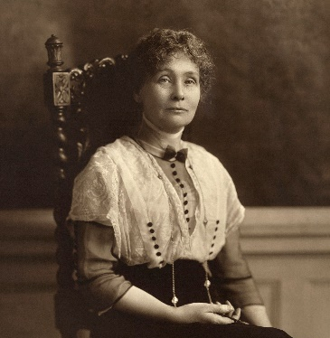
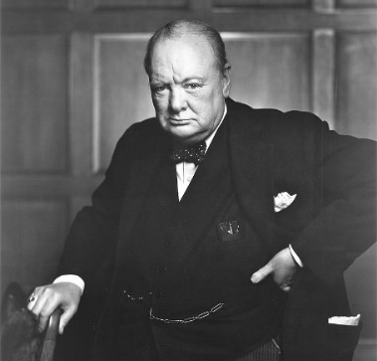
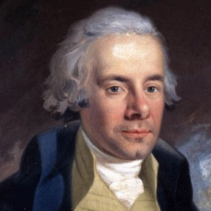
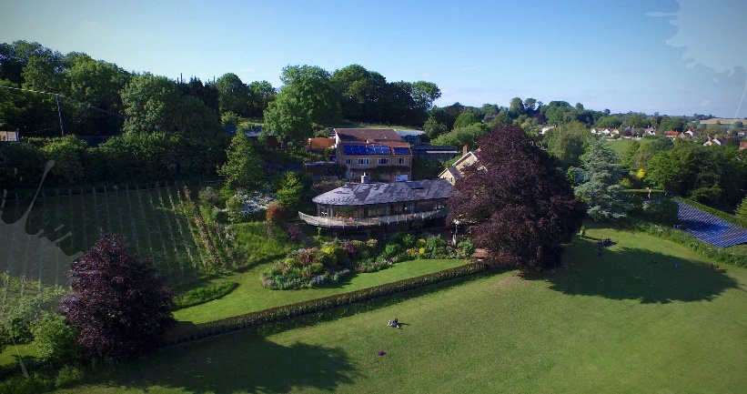
Owls Class reminders
PE – we have PE every Thursday and Friday
Homework –
Times tables will be handed out weekly and need to be returned on the indicated day for your child.
Homework will be set every Tuesday and due the following Monday. Each week will focus on a different topic relevant to that half-term
Reading – Please hear your child read regularly, children have a school reading slot timetable every day.
As a Historian
I can explain what the Transatlantic Slave Trade was
I can explain some of the causes that led Elizabeth Fry to campaign for this reformation
I can know what working life was like for children in the Victorian era
I can explain who Mary Seacole was
I can understand the role of women in the 19th century
I can understand about the life of Winston Churchill and his role in WW II
How you can help at home
Please hear your child read and question them on aspects of the book that they are reading.
If they read 3 times to an adult – signed in their reading records, stars are given out
Please encourage your child to complete their topic homework
Practise your times tables weekly
Wow Activity
Yr 4- Mill on the Brue
Yr 3 – Field to Food

