Slide 1
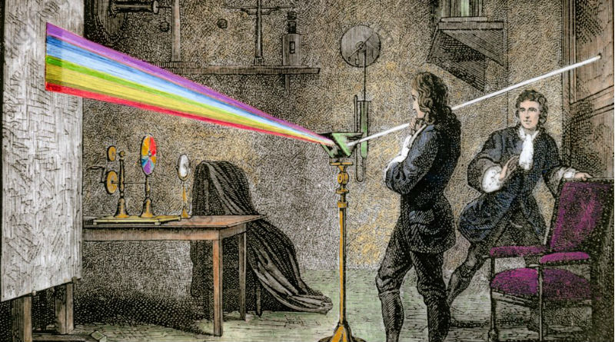
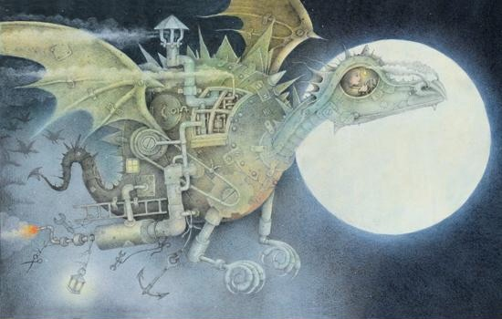
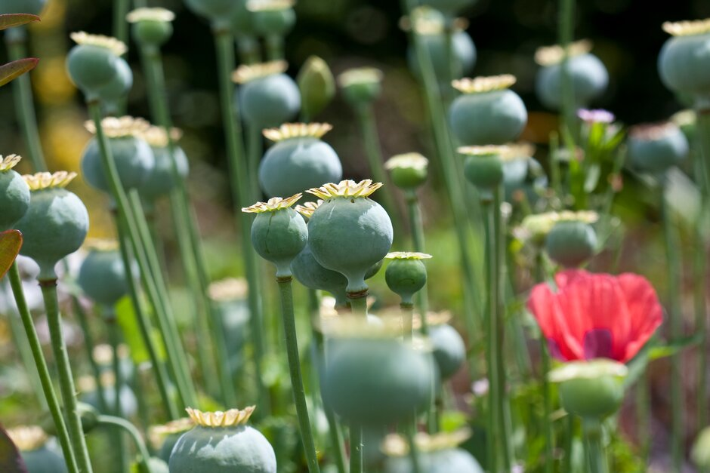
As a Scientist
I will understand why it is important for a plant to spread it’s seeds.
I will understand what is meant by the words ‘dispersal, disperse, pollination and seed.
I will understand that plants disperse their seeds in different ways.
I will understand that the design of the seed is crucial to the way it is dispersed.
I will understand what beans need to grow and discuss the concept of hydroponics.
I will understand what plants need to be healthy.
I will learn about the various functions of a plant and their importance.
I will observe cress growth and comment on my observations.
Growth
Badgers Class
As a Writer
I will be learning about the book, ‘The Dragon Machine’, written by Helen Ward.
I will make my own own guide to spotting dragons.
I will use positional language.
I will write a letter of advice including would, should and could.
I will make an Encyclopedia of Dragons which includes a map.
I will use expanded noun phrases.
I will create a diagram of my own idea for a dragon machine and annotate it with my own ideas.
I will write a description of the Dragon Machine flying and finally crashing.
I will create a story plan and ‘box up’ the main events.
I will innovate a story using the original story structure.
I will write, edit and publish my own story.
As a Mathematician
Year 2
I will explain that objects can be grouped in different ways.
I will represent groups as repeated addition.
I will represent groups as multiplication.
I will represent the two times table in different ways.
I will count in tens as the tens table.
I will represent the fives time table in different ways.
I will explain how groups of five and ten are related.
I will double two-digit numbers.
I will explain how halving and doubling are related.
I will halve two-digit numbers.
Year 3
I will know that strategies for crossing the tens boundary can be used to count and calculate across the hundreds boundary in multiples of 10.
I will know that knowledge of two-digit numbers can be extended to count across the hundreds boundary from/to any two-digit number in ones or tens.
I will rotate two lines around a fixed point to make different sized angles.
I will learn that a right angle is a ‘square corner’ and identify them in the environment.
I will learn that a square is a rectangle in which the four sides are equal length.

Slide 2
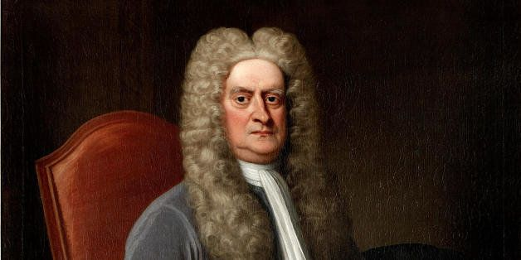
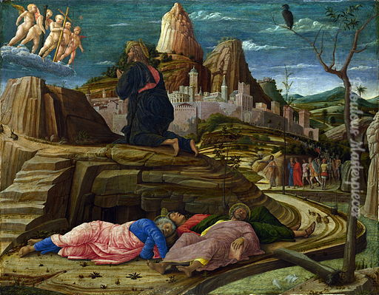
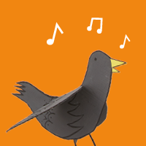
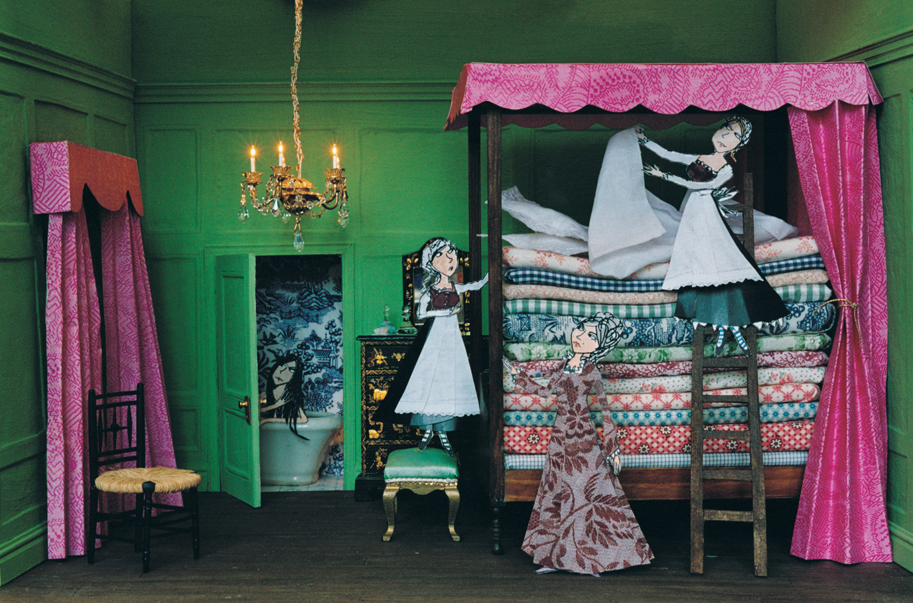
As an Artist
I will talk about other animators who make animations from their drawings such as Lauren Child and Andrew Fox.
I will use my sketchbook to explore my response to a chosen animator’s work.
I will design and create an animated character.
I will use my imagination to think about how my character might move.
I will create a background for my character.
I will use digital media to film my animation.
I will share my moving drawing either through an animation or demonstrating to my peers how it could move.
I will reflect and articulate my thoughts about my own artwork and that of my peers.
As a Computational Thinker
As a Religious Explorer
I will know and remember the meaning of salvation
I will retell the Easter story and know its meaning.
I will know how the symbols of Easter help us understand the meaning of Easter for Christians.
I will understand the meaning of ‘The Last Supper’ and ‘The Crucifixion’.
I will explore commands on a floor robot.
I will think about the language used to give directions.
I will give and follow instructions.
I will program a floor robot to move forwards and backwards.
I will combine four direction commands to create sequences of movements.
I will plan a simple program and also debug the program.
I will find more than one solution to solve a problem.
As a Musician
I will recognise and explore musical mood.
I will choose sounds to match a character, mood or theme.
I will sequence and combine sounds to tell stories and create effects.
I will create and perform soundscapes.

Slide 3
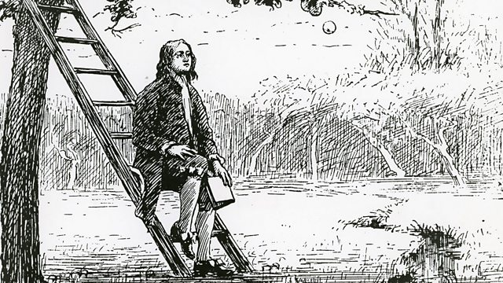
As an Historian
I will find out who Isaac Newton was and when he lived.
I will find out out about Isaac Newton’s scientific discoveries.
I will carry out scientific experiments connected to these discoveries,
I will find how Isaac Newton interacted with other people and why this was important.
I will find out how Isaac Newton let other people know about his work.
I will identify the similarities and differences between science in the seventeenth century and science now.
How you can help at home?
Please hear your child read
Please encourage your child to complete any homework they have
Please discuss any artwork you feel passionate about
Please practise counting with them. This can be forwards and backwards starting from any number below 1000.
Practise counting in 2s, 5s, 10s, 3s
Year 3 practise 3, 4 and 8 times tables.
As an Athlete
I will be able to explain why someone is working or performing well.
I will be able to recognise similarities and differences in performance.
I will develop and apply my dynamic balance on a line through
Focused skill development and competitive games.
Badgers Class reminders
PE – we have PE every Thursday and Friday
Homework – there will be 6 homework challenges this term
Reading – Please hear your child read every day, this will be recorded and added to your child’s achievements.
Wow Activities
Science Week-whole school
Year 2- Archery
Year 3- Ultimate frisbee

