Slide 1
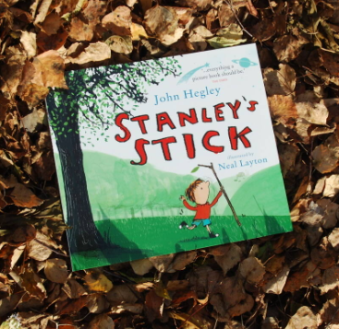
English
This term our text will be Stanley’s Stick by John Hegley and Neal Layton. It will explore the theme of magic and imagination through nature and the environment.
As a writer I will continue to develop the following skills….
Spelling and handwriting
Spell by using sound mats and other supporting resources within lessons.
Vocabulary and Grammar
How words can combine to make sentences.
Separate words with finger spaces.
Demarcate sentences with capital letters, full stops, question marks and exclamation marks.
Use suffixes ‘er’, ‘est’ in adjectives and use ‘ly’ to turn adjectives into adverbs.
Use commas to separate items in a list.
Use apostrophes to mark where letters are missing
Writing (composition)
Write sentences by
Saying out loud what I am going to write about
Composing a sentence orally before writing it.
Sequence sentences to form short narratives.
Re-reading what I have written to check it makes sense.
We will continue to edit using purple pens where appropriate.
Term 4 theme - Growth
English
I can…
Predict what might happen
Use my imagination to say and write what my stick can do
Sequence the story, using adverbs
Use adjectives to describe and create a noun phrase
Plan an alternative story using six ideas
Write my story, creating simple paragraphs.
Use the laptop to publish a small section of my story

Slide 2
As a reader
I will continue to develop the following skills through daily phonic lessons and reading throughout the week.
Word reading
Apply my phonic knowledge.
Read accurately by blending sounds in unfamiliar words containing graphemes already taught.
Read aloud accurately books that are consistent with my phonic ability.
Re-read these books to build up my fluency and confidence in word reading.
.
Reading comprehension
Develop reading for pleasure through story time, library visits and texts ordered through the Somerset Library to enhance the learning.
Recognise and join in with predictable phrases
Discussing word meanings, linking new meanings to those already known.
How can you help me at home?
Listen to me read regularly
Share books for pleasure.
As a mathematician I can
Explore strategies to add and subtract
Find out what happens when I add or subtract zero.
Recall number bonds to 10
Find the difference when subtracting
Double numbers and halve them as their inverse.
Use my knowledge of double and halves to find near doubles/halves.
Use my addition and subtraction facts for pairs of numbers
How can you help me?
Create opportunities to add objects together and write the equation.
Use maths in everyday activities – laying the table, handing out snacks etc.
Practise counting forwards and backwards up to 20 or beyond
Subitise amounts up to 10 (be able to recognise quantities presented to me i.e. group of 5 objects, 8 fingers etc)
Tell addition or subtraction maths stories using first, then and now

Slide 3
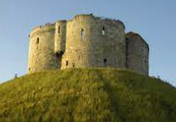
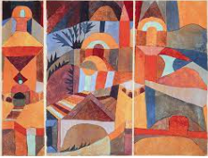
RE
Why does Easter matter to Christians?
I will learn the Easter story
I can discuss what are happy and
Sad events in the story.
I will think about why eggs
are connected to Easter
History
Castles.
As a historian I will
Discover who built the first
castles and why
Explore UK castles and those
built by the Normans
How are medieval castles built
and the lives of people who lived
there.
PSHE
I can explore my rights and respect
How can I take care of myself and others?
How can I look after my money.
How can I take care of my things.
I will be introduced to basic first aid.
Art
As an artist I will
Explore the art of Paul Klee and Emma Burleigh.
Find out what watercolour can do
Explore techniques that I can use
Create a new piece of art inspired by the focus artists
Music
I can explore how sound can be produced in different ways using my voice and instruments.
I can listen to a variety of music, sing simple songs and use facial expressions and actions to create a short performance to reflect a character.
PE
As an athlete
I will be continuing my swimming skills each week at Westbury Swimming pool.
With IG I will be focusing on multi sport skills.
Science
As a scientist I can
Solve problems using the knowledge of materials from last term.
Investigate waterproof materials and select the best one according to its property to mend a broken umbrella.
Investigate ice and puddles

