Slide 1
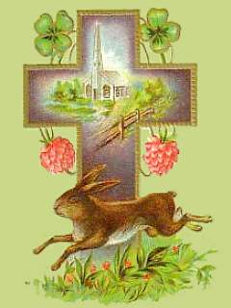
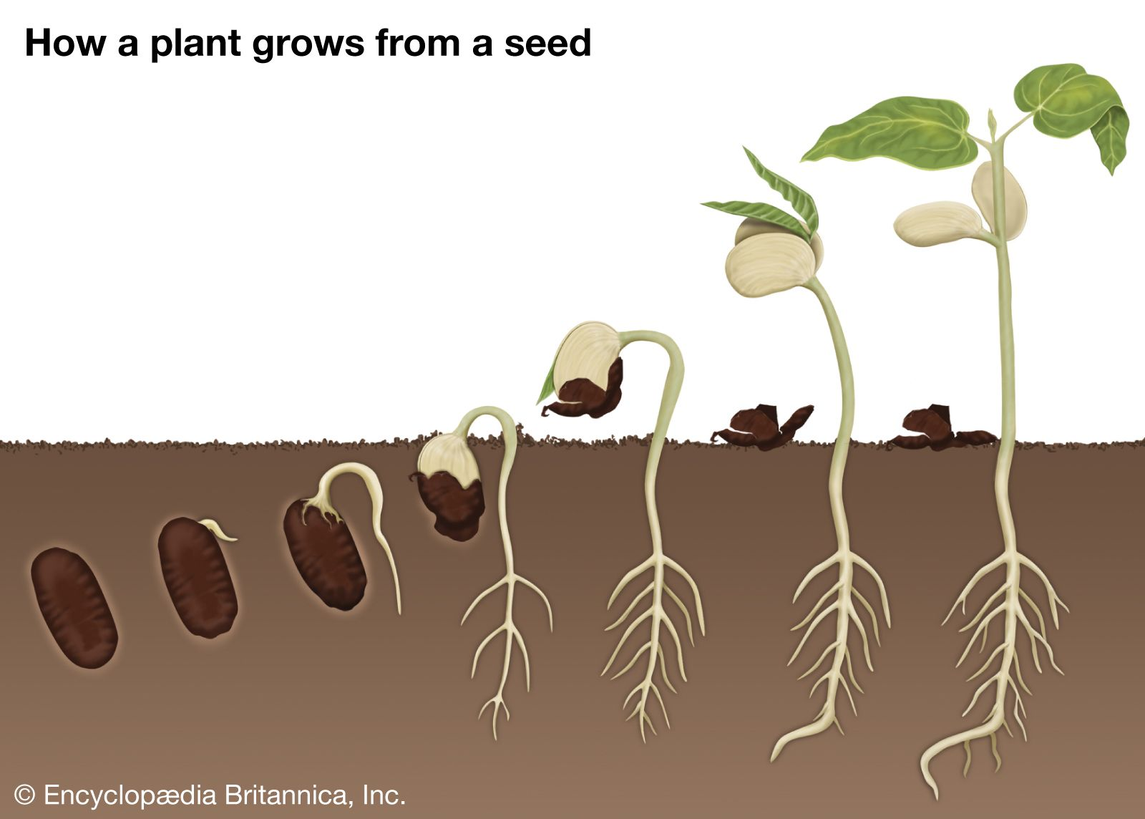
Rabbits Class Term 4
GROWING

Slide 2
What will we learn this term……….
About myself……. To become more independent around the classroom and at home
To learn how I can take care of others
To learn how I can care for our world
Physically……….. To improve my balance and co-ordination
To explore different movements
To continue to develop and build up strength in my fine motor skills
As a communicator…..To use talk to work out problems and organize my thinking
To talk about myself and my abilities
To voice my own opinions on a range of subjects

Slide 3
What will we learn this term……….
As a reader and writer……. I can read and write all sounds in words
I can use my knowledge of Common Exception words when reading and writing
I can form letters correctly and clearly
I can write a simple caption
I can tell the difference between a fiction and non-fiction book
As a religious learner……….. I can recognise Christian artefacts relating to Easter.
I can explain why some Christians make an Easter garden with a cross in it.
As a mathematician………… To recognise and represent arrays of numbers to 10 including subitising
To order and compare numbers to 10 To use the vocabulary equal and unequal
To recognise 3d shapes and use these within patterns
As a scientist………………….. To recognise the signs of Spring
To understand what is needed for seeds to grow
To recognise different herbs by smell and sight

Slide 4
How can I support as a parent……
Please read the weekly newsletters and check your emails regularly for communication from the school
Share your child’s reading books regularly, at least three times each book and return to school so we can change them.
Practice building the words in their phonics packs and the red ‘Common Exception Words’, daily practice for a few minutes is most effective.
Encourage your child to answer any questions in full sentences and give reasons for their answers if possible.
Encourage writing of any kind at home, remember the children will be using their phonics in their writing so they will not spell all words correctly!
Play the Literacy games sent home and record any comments on the WOW comment sheet provided

