Slide 1
Growth
Owls Class
As a Writer
I can use conjunctions, prepositions and adverbs that give cause and effect
I can discuss my ideas orally
I can use a range of question openers
I can use modal verbs
I can write multi-clause sentences
I can use adverbials of time
I can use pronouns to avoid repetition
I can begin to plan my own explanation text
I can compare the styles of two types of explanation text
I can identify technical language
I can use plural -s and possessive -s
I can edit my work for cohesion
As a Mathematician
I can explain what a square number is
I can use my knowledge of timetables to explore factor families
I can explain multiplication through the commutative law
I can explain division through the commutative law
I can explore multiplication as a distributive
I can solve two-part problems involving subtraction and addition
I can use the distributive law to derive multiplication beyond times tables
I can multiply and divide a number by 10 and 100
I can explore the relationship between the zeros when multiplying and dividing by 10 and 100
I can explain if one factor is 10 times the product will be 10 times.
As a Scientist
I can review data from charts to help categorise animals
I can create a collage of an Eatwell Plate in groups by sorting foods into categories
I can point to and explain different joints
I can make links between joints, muscles and bones
I can explain how the heart and lungs get oxygen to the muscles where it is needed to make energy
I can conduct a fair test to measure muscle strength

Slide 2
As a computational thinker
I can change the font and colour of the text
I can create a table on word
I can collect and put data onto a table
I can change the size and look of the table
I can compare findings to others in the class
I can create a table to match the data collected
As a religious explorer
I can explain why Easter matters to Christians
I can draw and explain the Easter Story
I can investigate how Christians follow Jesus’ examples.
I can look at the impact of the phrase ‘forgive and forget’
I can discuss how standing in others shoes can help understand them
As an athlete
I can throw a large ball and catch the rebound with 2 hands
I can throw a tennis ball and catch it with the other hand after 1 bounce
I can kick a ball with alternate feet
I can sit holding hands with toes touching and rock forwards, backwards and side-to-side
I can perform both short base challenges with eyes closed
I can stand on a low beam facing my partner, hold with both hands then swap places whilst maintaining the counter balance position
As Design Technician
I can explain what cams are
I can test how different shapes affect the movement of the follower
I can design a cam box based on a theme
I can build a cam box following my design
I can test and evaluate my design

Slide 3
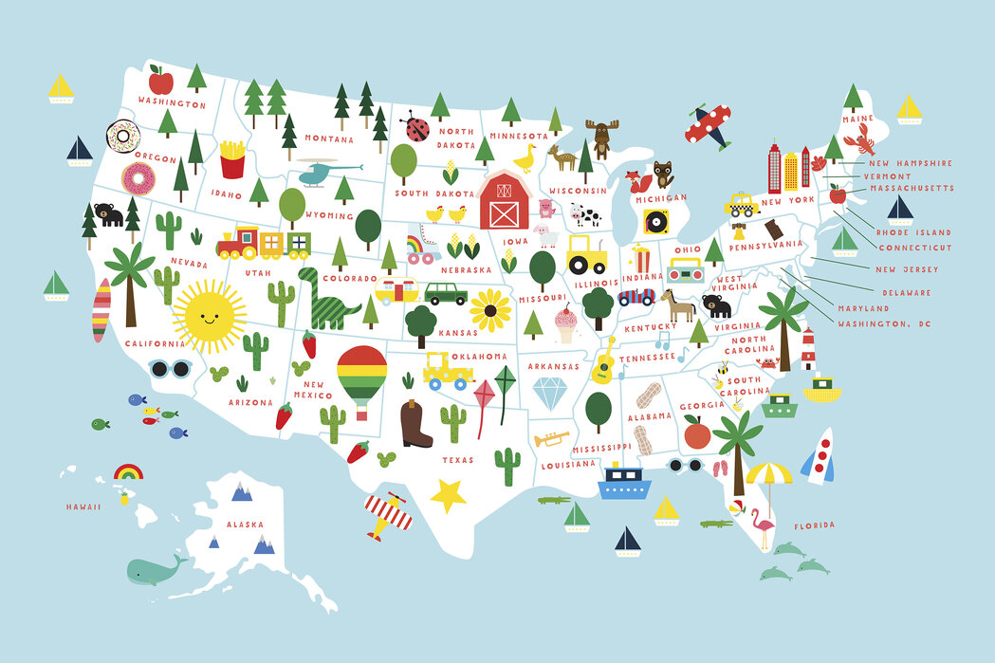
As a geologist
I can identify where the USA is on a map
I can locate some of the fifty states using an atlas
I can compare landscapes and explain similarities and differences
identify and locate some of the major cities in the USA
I can explain that national parks help to preserve wildlife
I can explain what earthquakes, tornadoes, blizzards and hurricanes are
Owls Class reminders
PE – we have PE every Thursday and Friday
Swimming on THURSDAY
Homework –
Times tables will be handed out weekly and need to be returned on the indicated day for your child.
Homework will be set every Tuesday and due the following Monday. Each week will focus on a different topic relevant to that half-term
Reading – Please hear your child read regularly, children have a school reading slot timetable every day.
How you can help at home
Please hear your child read and question them on aspects of the book that they are reading.
If they read 3 times to an adult – signed in their reading records, stars are given out
Please encourage your child to complete their topic homework
Practise your times tables weekly
“Strength and growth come only through continuous effort and struggle.” Napoleon Hill
Wow Activity
Food from the world
Science week
Easter service

