Slide 1
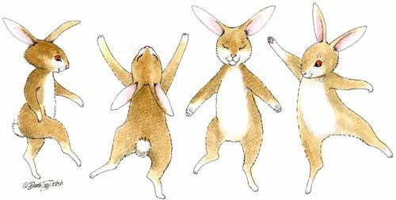
Rabbits class Term 3
BUILD IT….Building ourselves as superheroes and promoting positive self esteem

Slide 2
What will we learn this term……….
About myself……. To become more independent around the classroom
To listen to my own and others’ feelings
To show sensitivity to others’ needs
Physically……….. To talk about how to keep my body safe
To continue to be able to dress and undress myself
To build up strength in my gross motor skills e.g. running, hopping, skipping
To learn new skills in the water
As a communicator…..To continue to listen in a range of situations
To not interrupt when others are talking
To give reasons for my opinions

Slide 3
What will we learn this term……….
As a reader and writer……. I can read and write sounds in words
I can use my knowledge of Common Exception words when reading and writing
I can form letters correctly and clearly
I can write a simple word
I can retell stories and use new vocabulary that I learn
As a religious learner……….. I can reflect on my own special places
I can recognise how other cultures celebrate and discuss similarities and differences
As a mathematician………… To recognise 0 as a quantity
To use addition with numbers to 5
To talk about and use shapes, saying their names and describing their properties
As a scientist………….……… To explore the natural world around them
To describe what they see, hear and feel whilst outside.
To make different objects from materials

Slide 4
How can I support as a parent……
Please read the weekly newsletters and check your emails regularly for communication from the school
Share your child’s reading books regularly, at least three times each book and return to school so we can change them.
Practice building the words in their phonics packs and the red ‘Common Exception Words’, daily practice for a few minutes is most effective.
Play the Maths games we will be sending home weekly and make a comment on the WOW sheets
Practice drying themselves after bath-time and changing into pyjamas to help with swimming!
If you are able to spare an hour or two we are always looking for parent helpers to come and hear children read at school, please let us know if you are interested!

