Slide 1
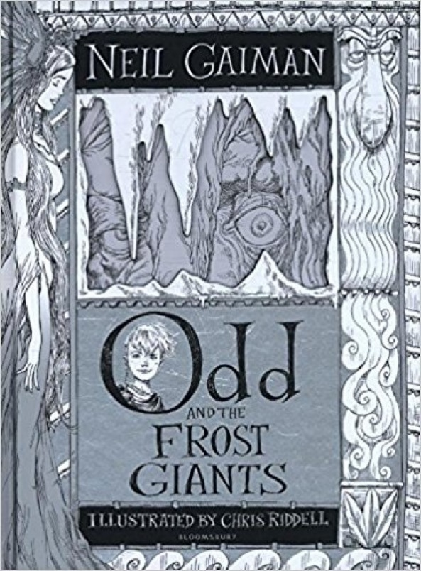
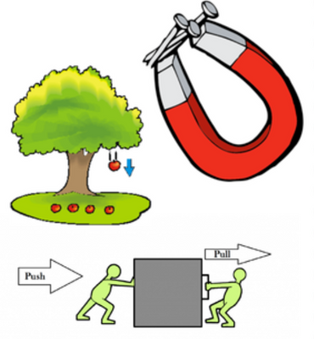
Build It!
Owls Class
As a Writer
I can use speech marks to show direct speech
I can use punctuation in speech
I can create a setting description
I can use root words to aid spelling
I can use conjunctions to extend sentences
I can predict what the text will be about
I can write a letter as someone else
I can use a thesaurus to extend my vocabulary
I can write a narrative recount
I can think of alternative perspectives
I can continue to use the skill of paragraphs
As a Mathematician
Yr 4
I can see a relationship between 3x table
I can problem-solve 3x table
I can 6x table, relationship and problem-solving
I can 3x and 6x tables relationship
I can 9 x table, relationship and problem-solving
I can understand divisible rules
I can use these rules for 3 and 6x tables
Yr 3
I can become familiar with the tools to measure volume and capacity
I can estimate a mass/volume, measure a mass/volume and record in a table
I can rotate two lines around a fixed point to make different-sized angles
I can draw triangles and quadrilaterals and identify vertices
I can learn that a rectangle is a 4-sided polygon with four right angles
I can cut rectangles and squares on the diagonal and investigate the shapes they make
See a
As a Scientist
I can compare how things move on different surfaces
I can notice that some forces need contact between two objects
I can observe how magnets attract or repel each other
I can compare and group everyday materials based on whether they are attracted to a magnet
I can describe magnets as having two poles
I can predict whether two magnets will attract or repel each other, depending on which poles are facing

Slide 2
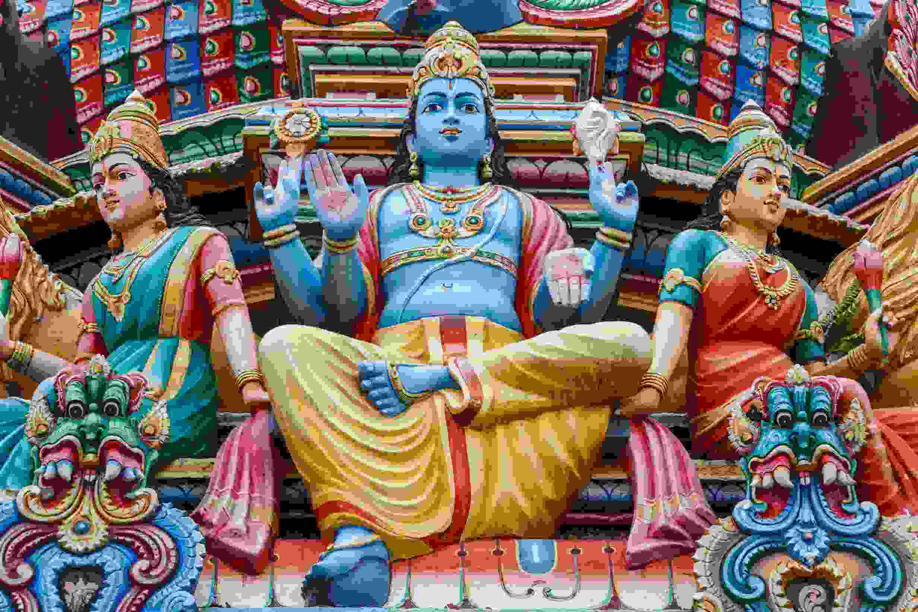
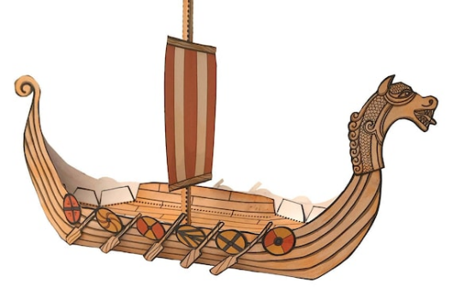
As a technician
I can program a computer by typing commands
I can use a template to draw what I want my program to do
I can identify repetition in everyday tasks
I can predict the outcome of a program containing a count-controlled loop
I can use a procedure in a program
I can make use of my design to write a program
As a religious explorer
I can recall the story of Rama, commonly told at the festival of Divali
I can explain how Hindu holy books describe Rama AND Krishna
I can recall where Hindus aim to visit
I can describe the importance and Avatars
I can explain the concept of Hindu’ God in other divine forms
I can explain the importance of Divali
I can explain the meaning of key concepts such as Deity and Dharma.
As an athlete
I can understand ways (criteria) to judge performance.
I can explain what I am doing well.
I can begin to order instructions, movements and skills.
I can identify specific parts of performance to work on.
I have begun to identify areas for improvement.
With help, I can recognise similarities and differences in performance.
As a Design Technologist
I can explain the purpose of Viking longboats
I can say what materials were available in the Viking time period
I can design my longboat using materials available
I can build a longboat following my design
I can test my longboat to see if it will float

Slide 3
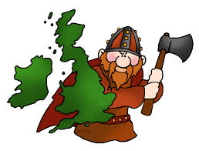
As a Historian
I can understand what an archaeologist does and why they excavate certain sites
I can explain the terms migrate, invade and settle?
I can describe what they know about the lives of the Picts and Scots?
I can compare the lives of rich and poor Anglo-Saxons?
I know what the term ‘culture’ means?
I understand the terms ‘change’ and ‘continuity’?
Owls Class reminders
PE – we have PE every Wednesday and Friday
Homework –
Times tables will be handed out weekly and need returning on the indicated day for your individual child.
Homework will be set every Tuesday and due the following Monday. Each week will focus on a different topic relevant to that half-term
Reading – Please hear your child read regularly, children have a school reading slot timetable every day.
How you can help at home
Please hear your child read and question them on aspects of the book that they are reading.
If they read 3 times to an adult – signed in their reading records, stars are given out
Please encourage your child to complete their topic homework
“To build your knowledge you must have a strong foundation and build on top of those blocks” - Unknown
Wow Activity
To be like a Viking

