Slide 1
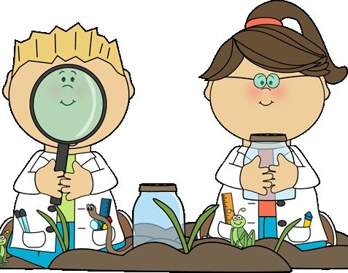
Discover
Owls Class
As a Writer
I can listen to and discuss a wide range of poetry.
I can prepare poems to read aloud.
I can discuss my understanding and explain the meaning of words in context.
I can identify how language, structure, and presentation contribute to meaning.
I can use a dictionary to check the meaning of words that they have read.
I can use adverbs, ad prepositions
I can use a range of sentence structures.
I can proofread for spelling and punctuation errors.
I can retrieve and record information from non-fiction.
I can write noun-phrases extended with prepositions.
I can create paragraphs that are organised around a theme
I can make changes in my writing so that it flows from one paragraph to another.
As a Mathematician
Year 3
I can recognise the digit in three digit numbers and represent and partition numbers to 1,000., I can count in 100’s, 50’s, and find 1, 10, 1000 more or less than a given number.
I can compare objects and numbers to 1,000 and order these numbers.
I can add and subtract multiples of 100, with and without exchange.
I can estimate and check answers
Year 4
I can recognise digits in four digit numbers and I can represent and partition numbers up to 10,000, I can count in 1,000’s, 25’s, and find a 1,000 more or less than a given number.
I can begin to use and understand negative numbers.
I can add and subtract 4 digit with and without exchanges.
I can estimate and check answers
As a Scientist
I can talk about the 7 life processes that characterise all living things
I can use secondary sources to research interesting facts about green plants
I can use an invertebrate key to identify the group and type of creature found
I can make a classification key for living things using group labels
I can take accurate measurements of temperature over time
I can research how mammals adapted to their environment

Slide 2
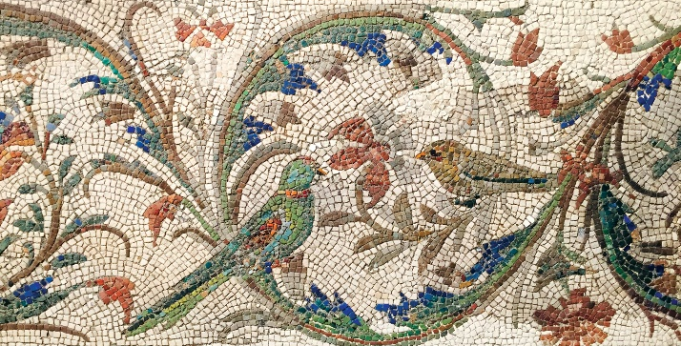
As a technician
I can describe the Internet as a network of networks
I can describe networked devices and how they connect
I can explain the types of media that can be shared on the WWW
I can explain what media can be found on websites
I can explain that websites and their content are created by people
I can explain that not everything on the World Wide Web is true
As a religious explorer
I can say what the Bible is
I can discuss the importance of God as a father
I can explain what happens in Baptisms
I can talk about the Holy Spirit
I can explain the significance of a church
As an athlete
I can react positively when things get challenging
I can hold a balance on both legs
I can skip with control
I can move in a zig-zag pattern
I can maintain balance on both legs with increasing number of time
I can persevere and improve with time on a task
As a Design Technologist
I can analyse patterns from Roman mosaics
I can explore colours and patterns used
I can use and compare materials Romans used
I can design my own mosaic
I can create and evaluate my mosaic

Slide 3
As a Historian
I can identify some of the countries that were under the rule of the Romans
I can explain what a republic is
I can ask historical questions about a variety of topics
I can understand what a gladiator is and some of the aspects of a gladiator’s life
I can recall ancient Roman gods and goddesses
Owls Class reminders
PE – We have PE every Wednesday and Friday
Homework - Will be set every Tuesday and due the following Monday. Each week will focus on a different topic relevant to that half-term
Reading – Please hear your child read regularly, children have a school reading slot timetable every day.
How you can help at home
Please hear your child read and question them on aspects of the book that they are reading.
Every Friday we check to see if you have listened to your child read and signed their reading record.
Please encourage your child to complete their topic homework
No man ever made a great discovery without the exercise of the imagination
– George Henry Lewes
Wow Activity
Become a Roman

