Slide 1
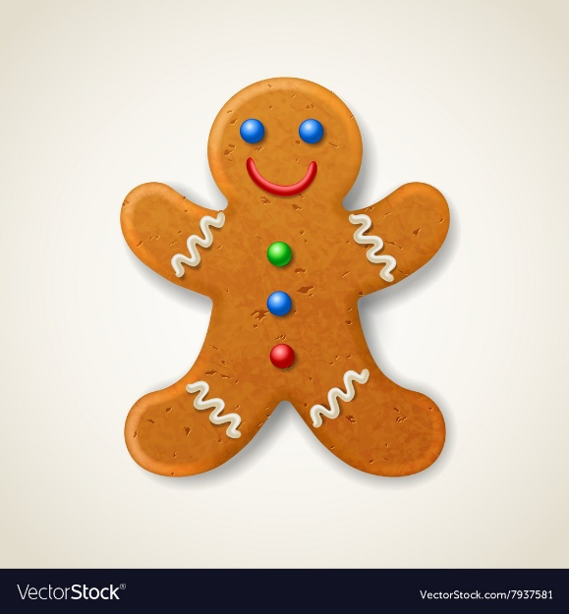
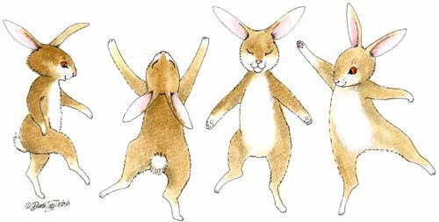
Rabbits class: Discover

Slide 2
What will we learn this term……….
About myself……. To share my ideas with other children and take turns
To become confident in my new class environment
To trying new activities and speak in a group
To follow the class rules
Physically……….. To experiment with different ways of moving
To be able to dress and organise my things ready for hometime
As a communicator… To listen in a range of situations
To follow instructions I am given
To use talk to organise my thoughts
To retell familiar stories and rhymes

Slide 3
What will we learn this term……….
As a reader/writer……. To join in repeated refrains in a story
To hold a pencil using the tripod grip
To write my name and other phonics sounds I learn
As a religious learner….. To know what makes me special
To know where I belong
As a mathematician… To develop my counting skills
To develop my subitising skills
To explore numbers within 5
To compare sets of objects

