Slide 1
Year 4 residential trip
24th April – 26th April

Slide 2
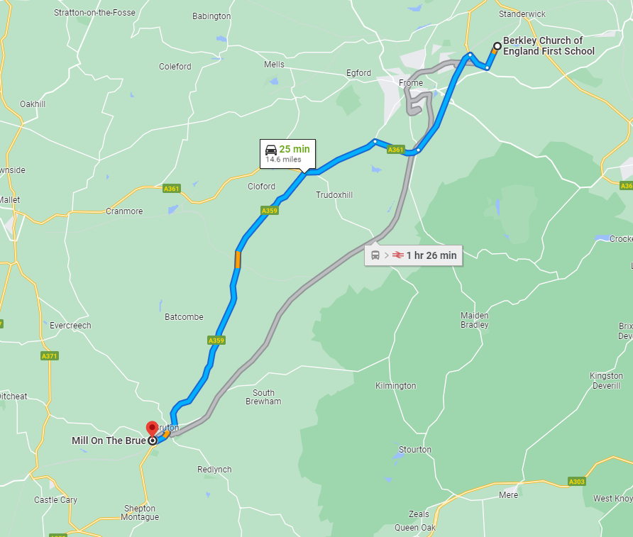
It is based in the town of Bruton
25 minutes away, under 15 miles
It is close enough to home
But a different and new experience

Slide 3
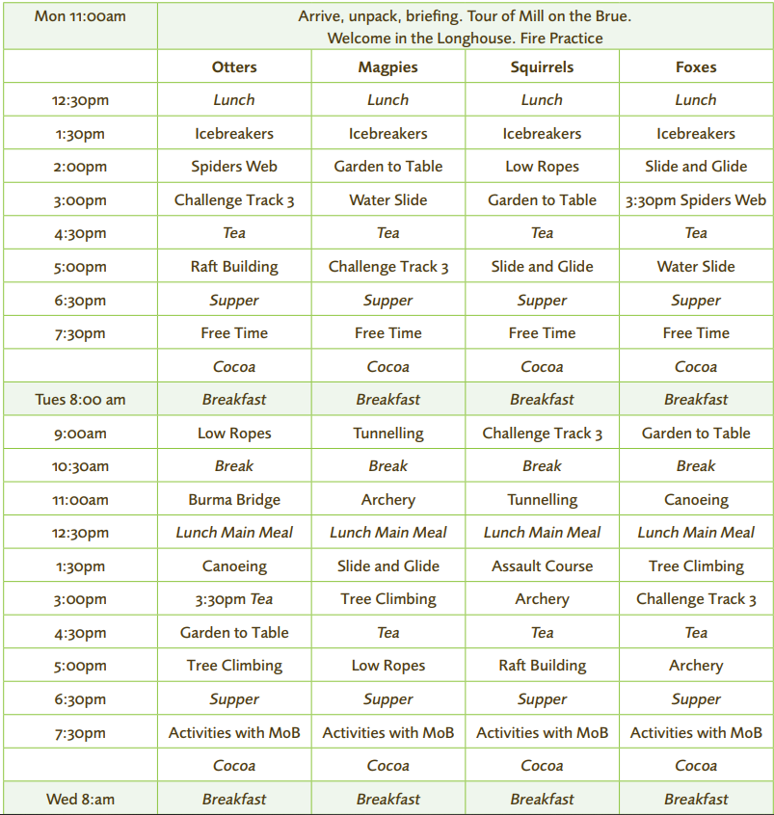
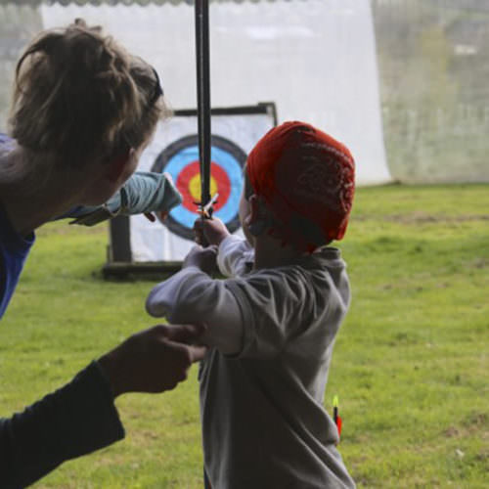
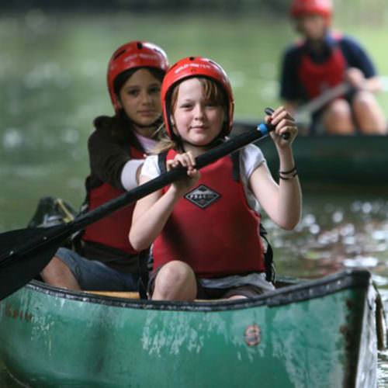
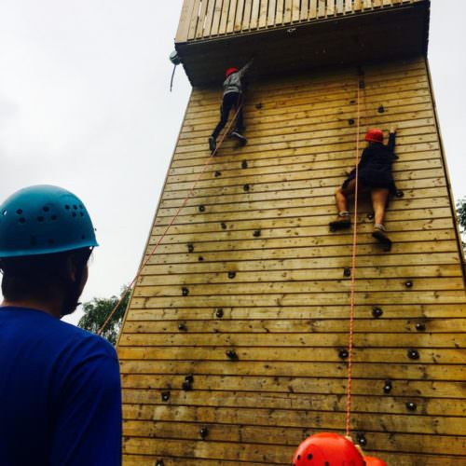
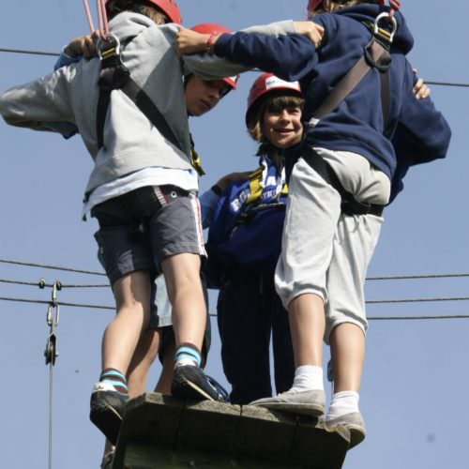
Example of activities and timings.

Slide 4
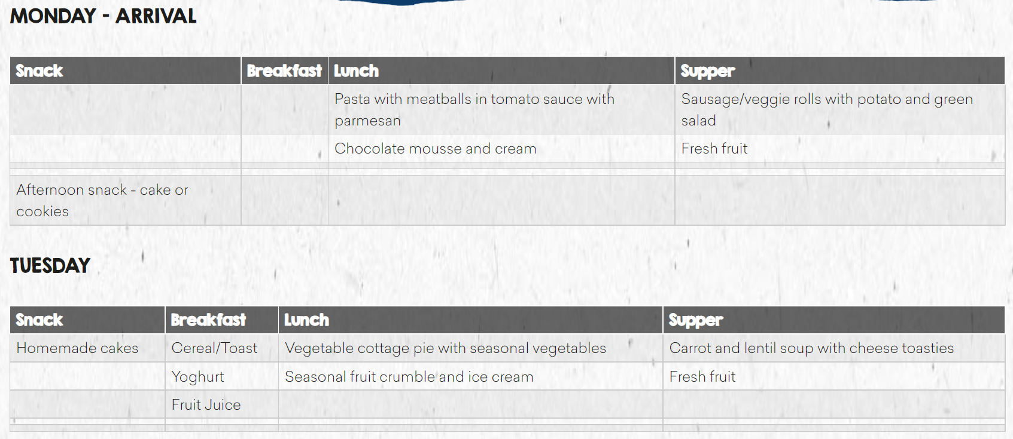
A TYPICAL SAMPLE MENU
About 85% of the fruit and vegetables are grown at Mill on the Brue using organic methods.

Slide 5
Nights away
Other schools will be at Mill on the Brue at the same, we do NOT share accommodations/buildings with them.
Girls and boys will sleep in separate rooms.
They will be with their friends, I will get them to write down 2 friends who they want to be with.
No phones or electronics – I will have all contact details if there is an emergency.
I will send regular updates and photos to the school, which will send them out for you to see.
Information regarding sleeping, please make me aware of so we can help and keep everyone safe.

Slide 6
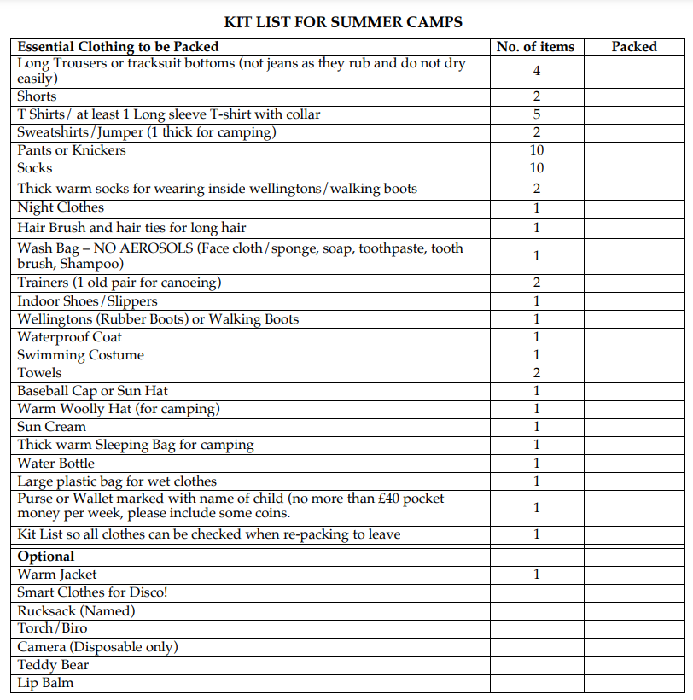
What you will need – recommended from Mill on the Brue Nearer the time I will send out a kit list of essentials and recommendations.

Slide 7
Payment
Total £235 – April 5th 2023
Deposit £50 – December 5th 2022
December 5th DEPOSIT | £50
January 5th | £35
February 5th | £50
March 5th | £50
April 5th | £50
Deposit needs to be paid to secure your child a place on this trip

Slide 8
Information from Mill on the Brue
Children will then need to walk up with the drive with their cases, so it is advisable to have one with wheels.
Please would students and staff not bring any sweets/snacks
We are a nut free Centre.
PLEASE NAME ALL BELONGINGS CLEARLY.
Any items of clothing left behind will be returned if £5.00 p & p is sent to us, otherwise we give the items to charity at the end of the year.
Please DO NOT send your child with any valuable items, particularly jewellery, etc., as we cannot guarantee it’s safety

Slide 9
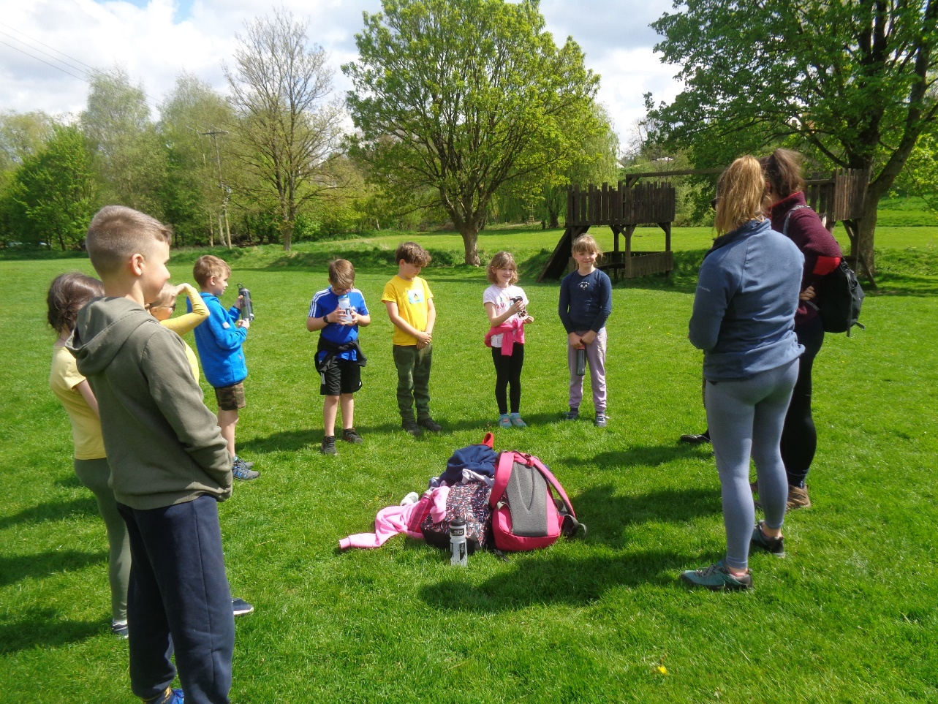
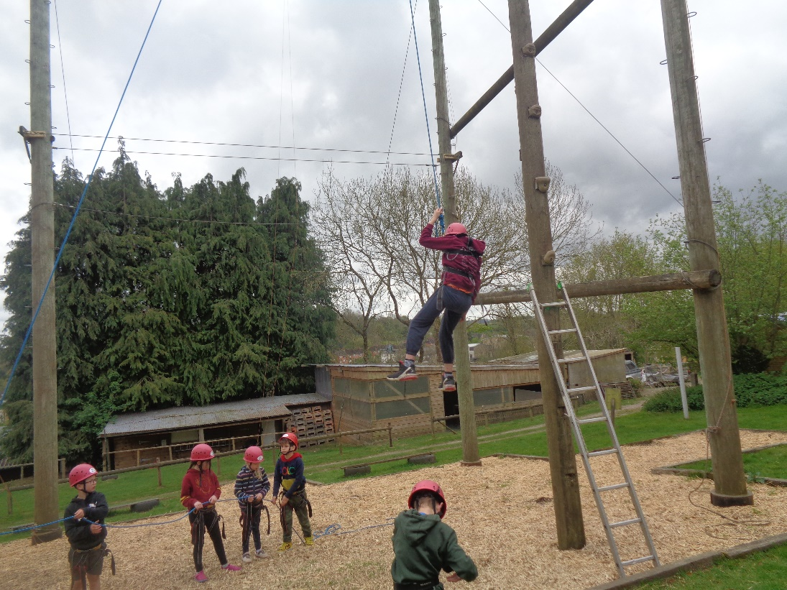
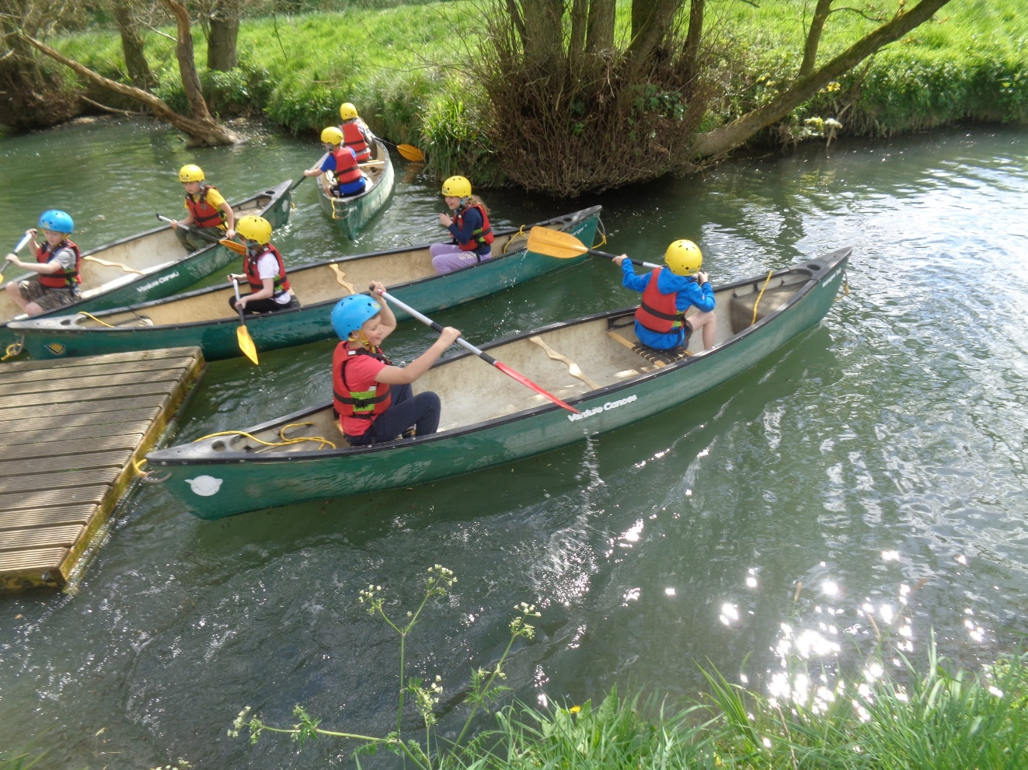
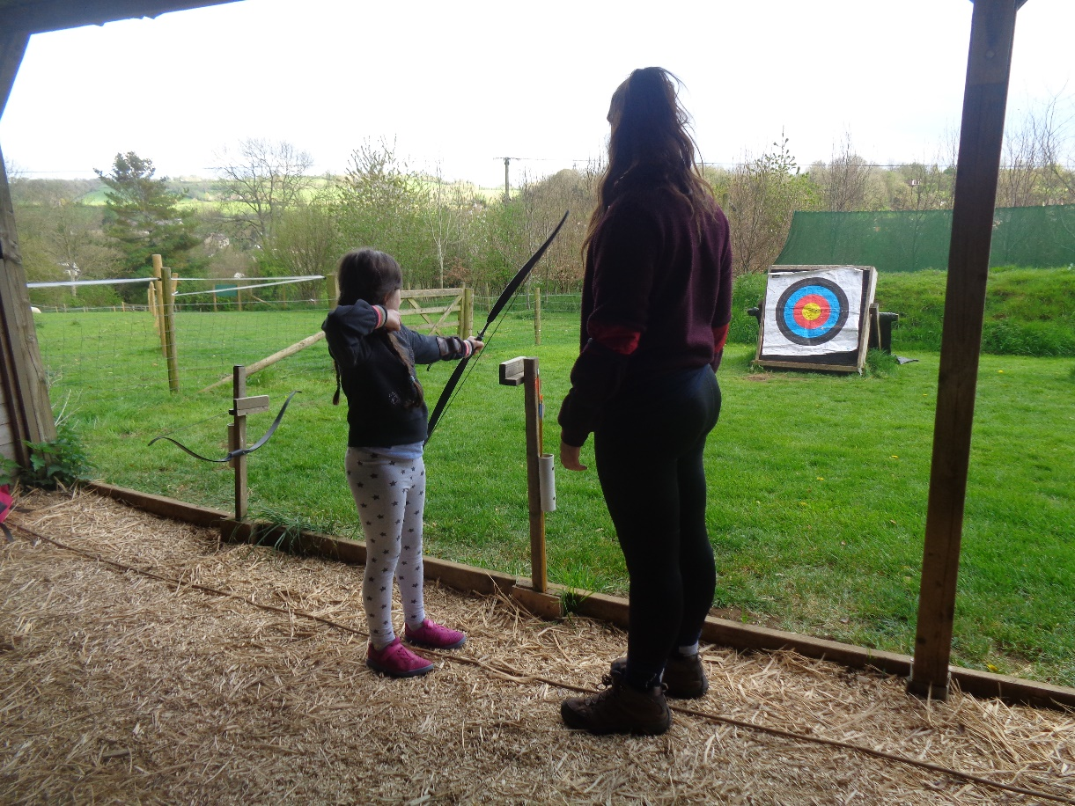
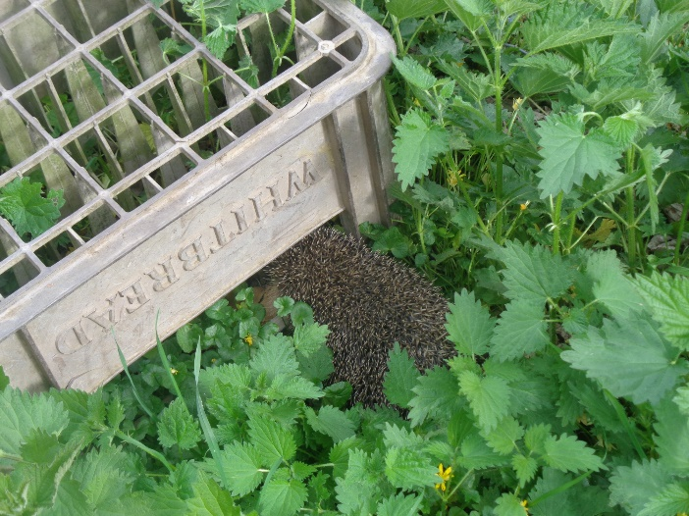
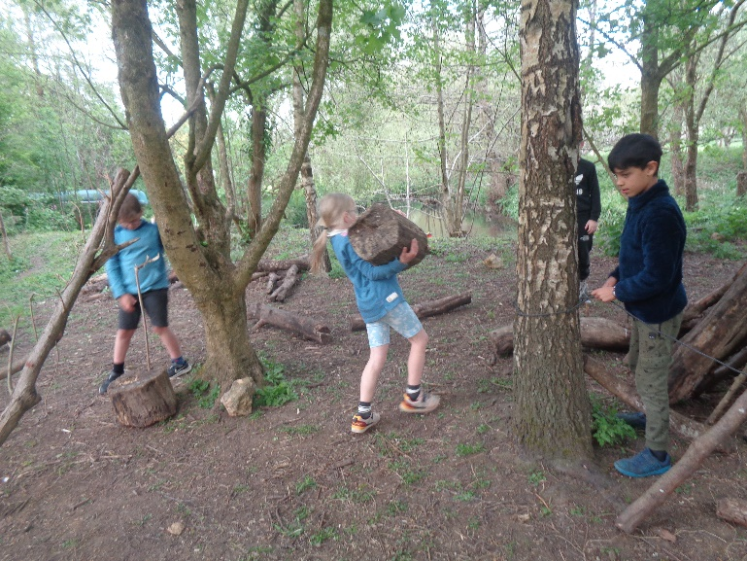
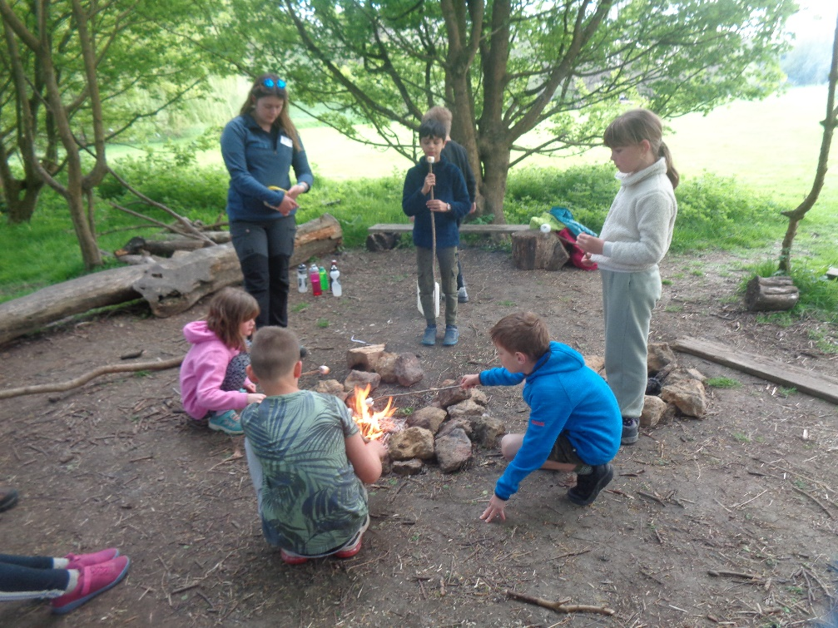
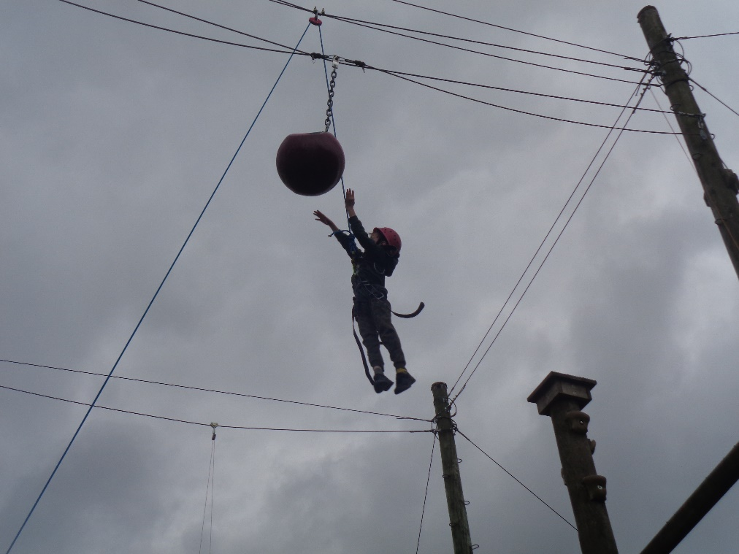

Slide 10
Welcome videos
https://www.youtube.com/watch?v=Pmh8JDPQkYQ
A video from Mill on the Brue explaining and showing what they do
https://www.millonthebrue.co.uk/schools-and-groups/school-trips/
A link to their website providing information for school trips

Slide 11
Any questions
If you have any questions please don’t hesitate to ask.
In the New Year, more information will be sent out with exact accommodation, activities and kit list.

