Slide 1
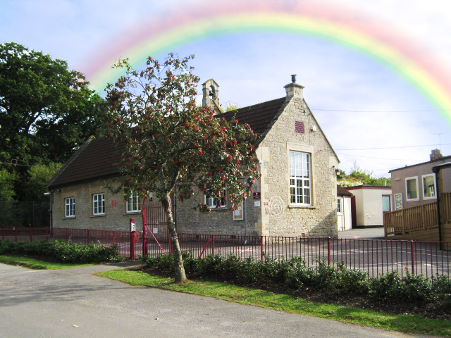
Year 2 SATs Workshop

Slide 2
May 2019
Welcome and thank you for coming. Although it may seem daunting that our little Year 2 children have to sit these exams next year it is important that we teach and equip them to deal with the exams and thus allow every child to perform to their maximum potential.
We ensure that the exam process is a relaxed and calm activity.

Slide 3
What are SATs?
SATs are the assessments made at the end of both Key Stage 1 and Key Stage 2.
The role of the SATs tests is to support teachers in making their final judgement of teacher assessment.
Your child’s attainment at the end of KS1 will be reported as: working towards, working at or working at greater depth in relation to the Year 2 objectives.
3 parts – Maths, Reading and SPAG
No fixed dates – have the whole of May to complete.
No holidays in May please!

Slide 4
Maths
There are two papers – arithmetic and problem solving.
No time limit but approximately 20 minutes for arithmetic paper and 35 minutes for problem solving.

Slide 5
Reading
There are two papers – paper 1 and paper 2
Both papers are marked out of 20
Paper 1 takes approximately 30 minutes
Paper 2 takes approximately 40 minutes
Paper 2 – answer booklet is separate

Slide 6
SPAG
There are two papers – a spelling paper and a grammar question paper
The spelling paper is 20 words and takes approximately 15 minutes to complete
The grammar question paper takes approximately 20 minutes to complete

Slide 8
How to help your child
First and foremost, support and reassure your child that there is nothing to worry about and that they should always just try their best. Praise and encourage!
Ensure your child has the best possible attendance at school.
Support your child with any homework tasks – these are related to the tests and are designed to help your child practise the skills they will need.
Reading, spelling and arithmetic (e.g. times tables) are always good to practise.
Talk to your child about what they have learnt at school and what book(s) they are reading (the character, the plot, their opinion).
Make sure your child has a good sleep and healthy breakfast every morning

Slide 13
Please take a look at the past papers and the performance descriptors.
Please don’t hesitate to ask us if you have any questions.
Free feel to take home a ‘how to help your child’ sheet.
Many Thanks

