Slide 1
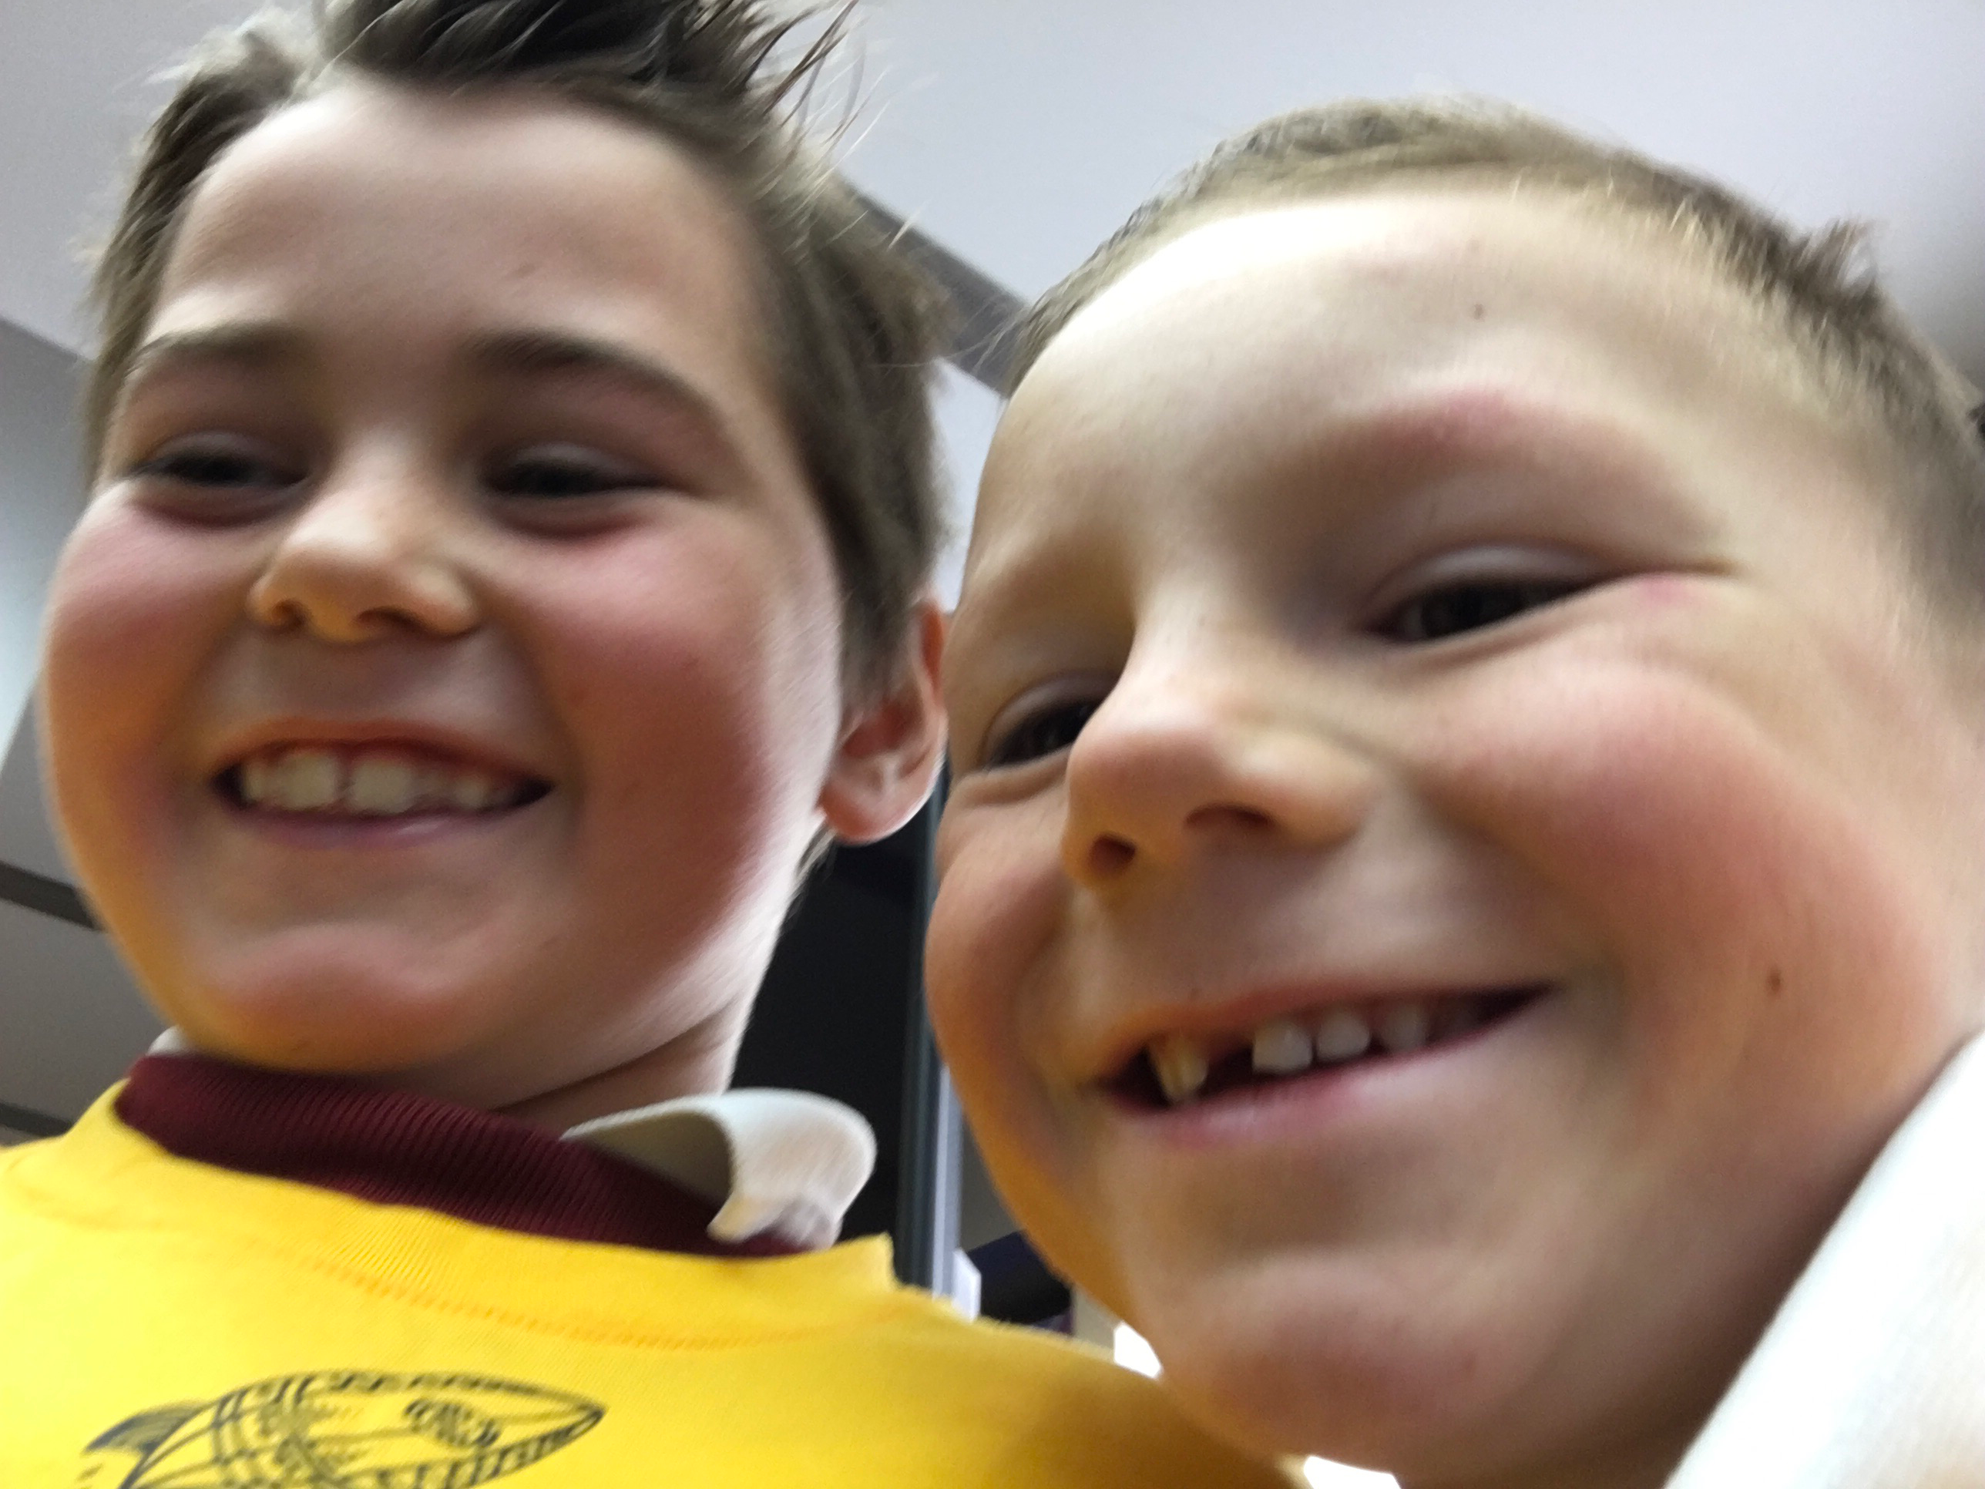
Rudy and Finlay

Slide 2
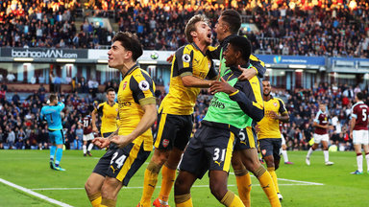
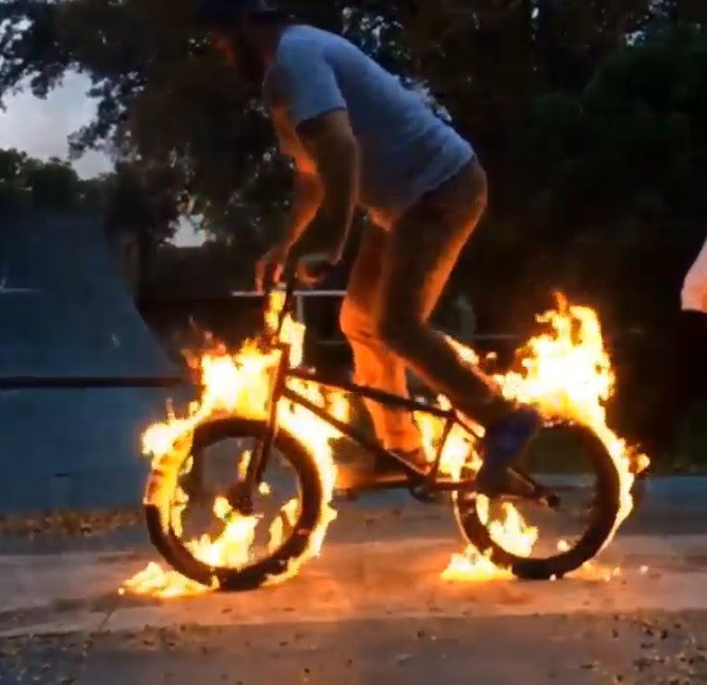
Our Hobbies
My hobbie is football
My hobbie is bmx

Slide 3
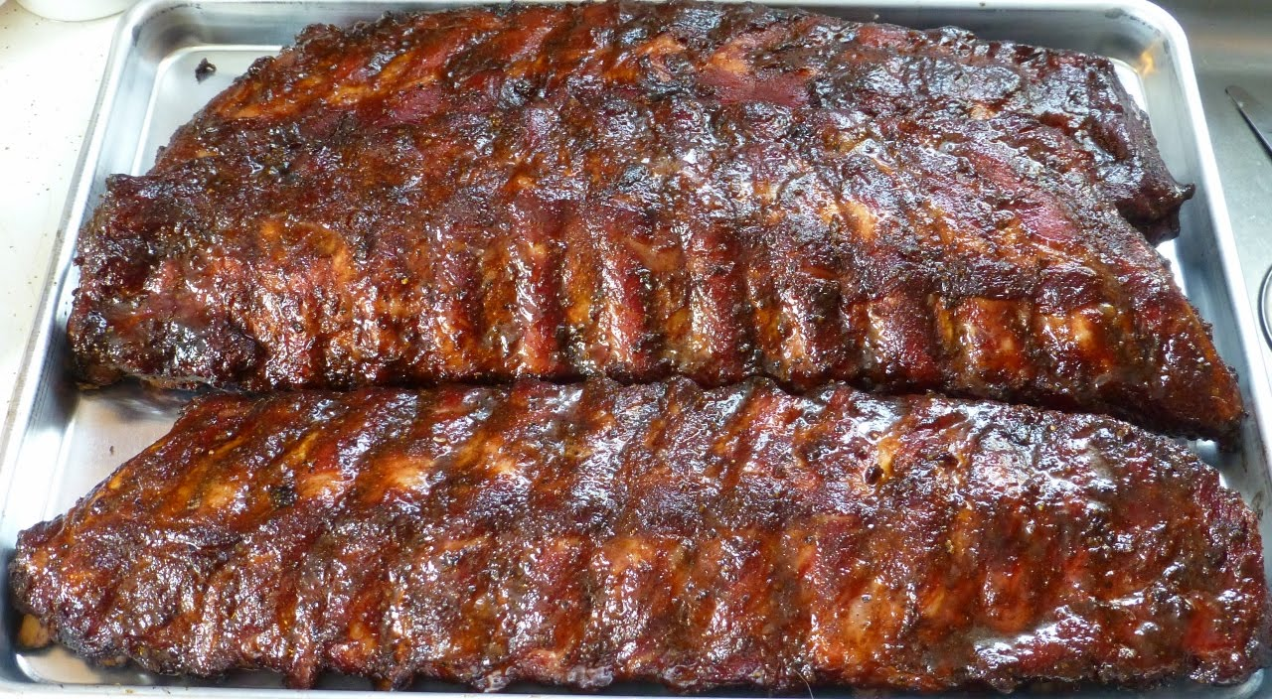
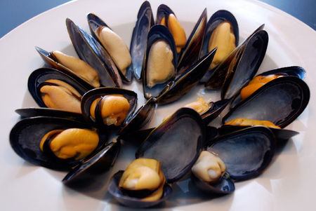
Rudy's favourite food
Finlay's Favourite food
I like BBQ chicken ribs
I like mussels.

Slide 4
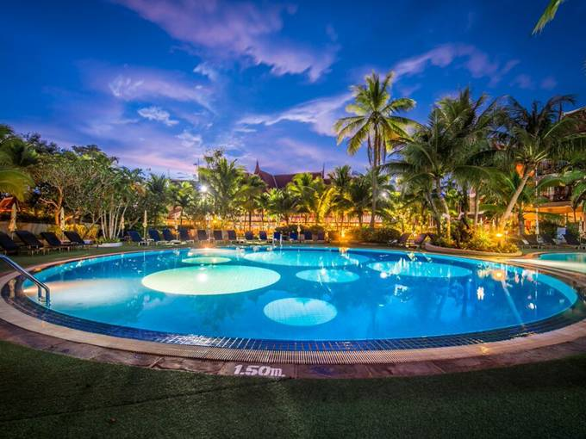
Rudy's Favourite holiday
Finlay's Favourite holiday
Is Thailand 🇹🇭
Italy 🇮🇹

Slide 5
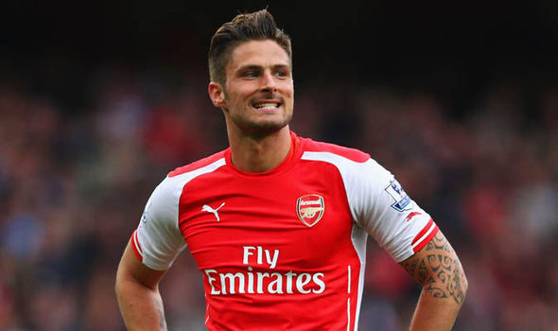
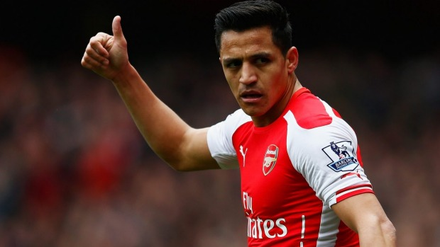
Finlay wants to be a
Rudy wants to be ....
A football player
Football player

Slide 6
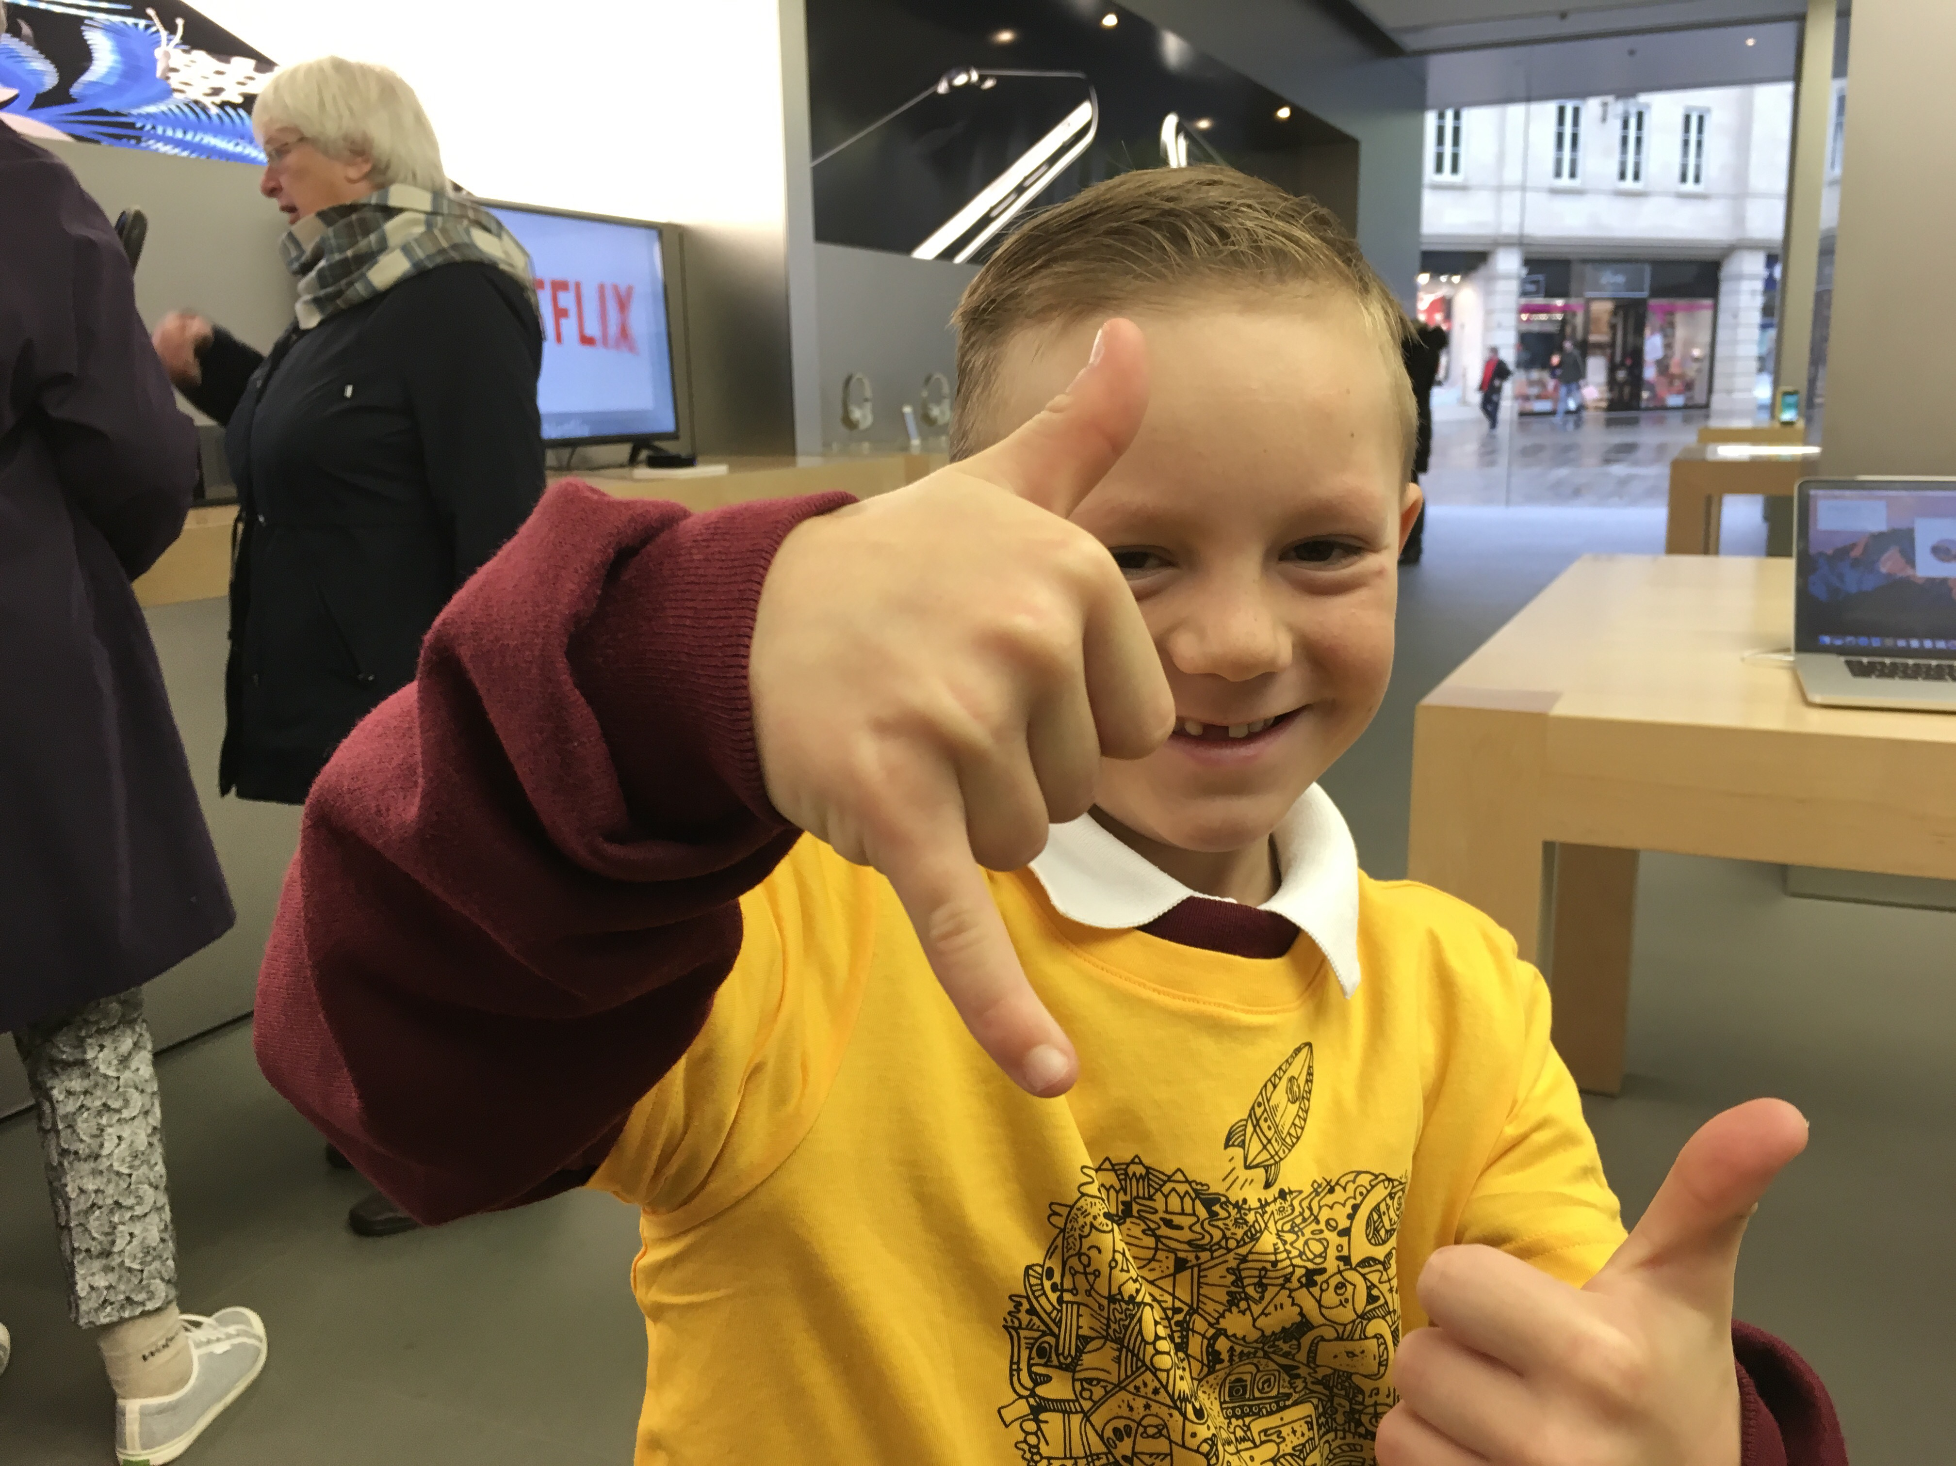
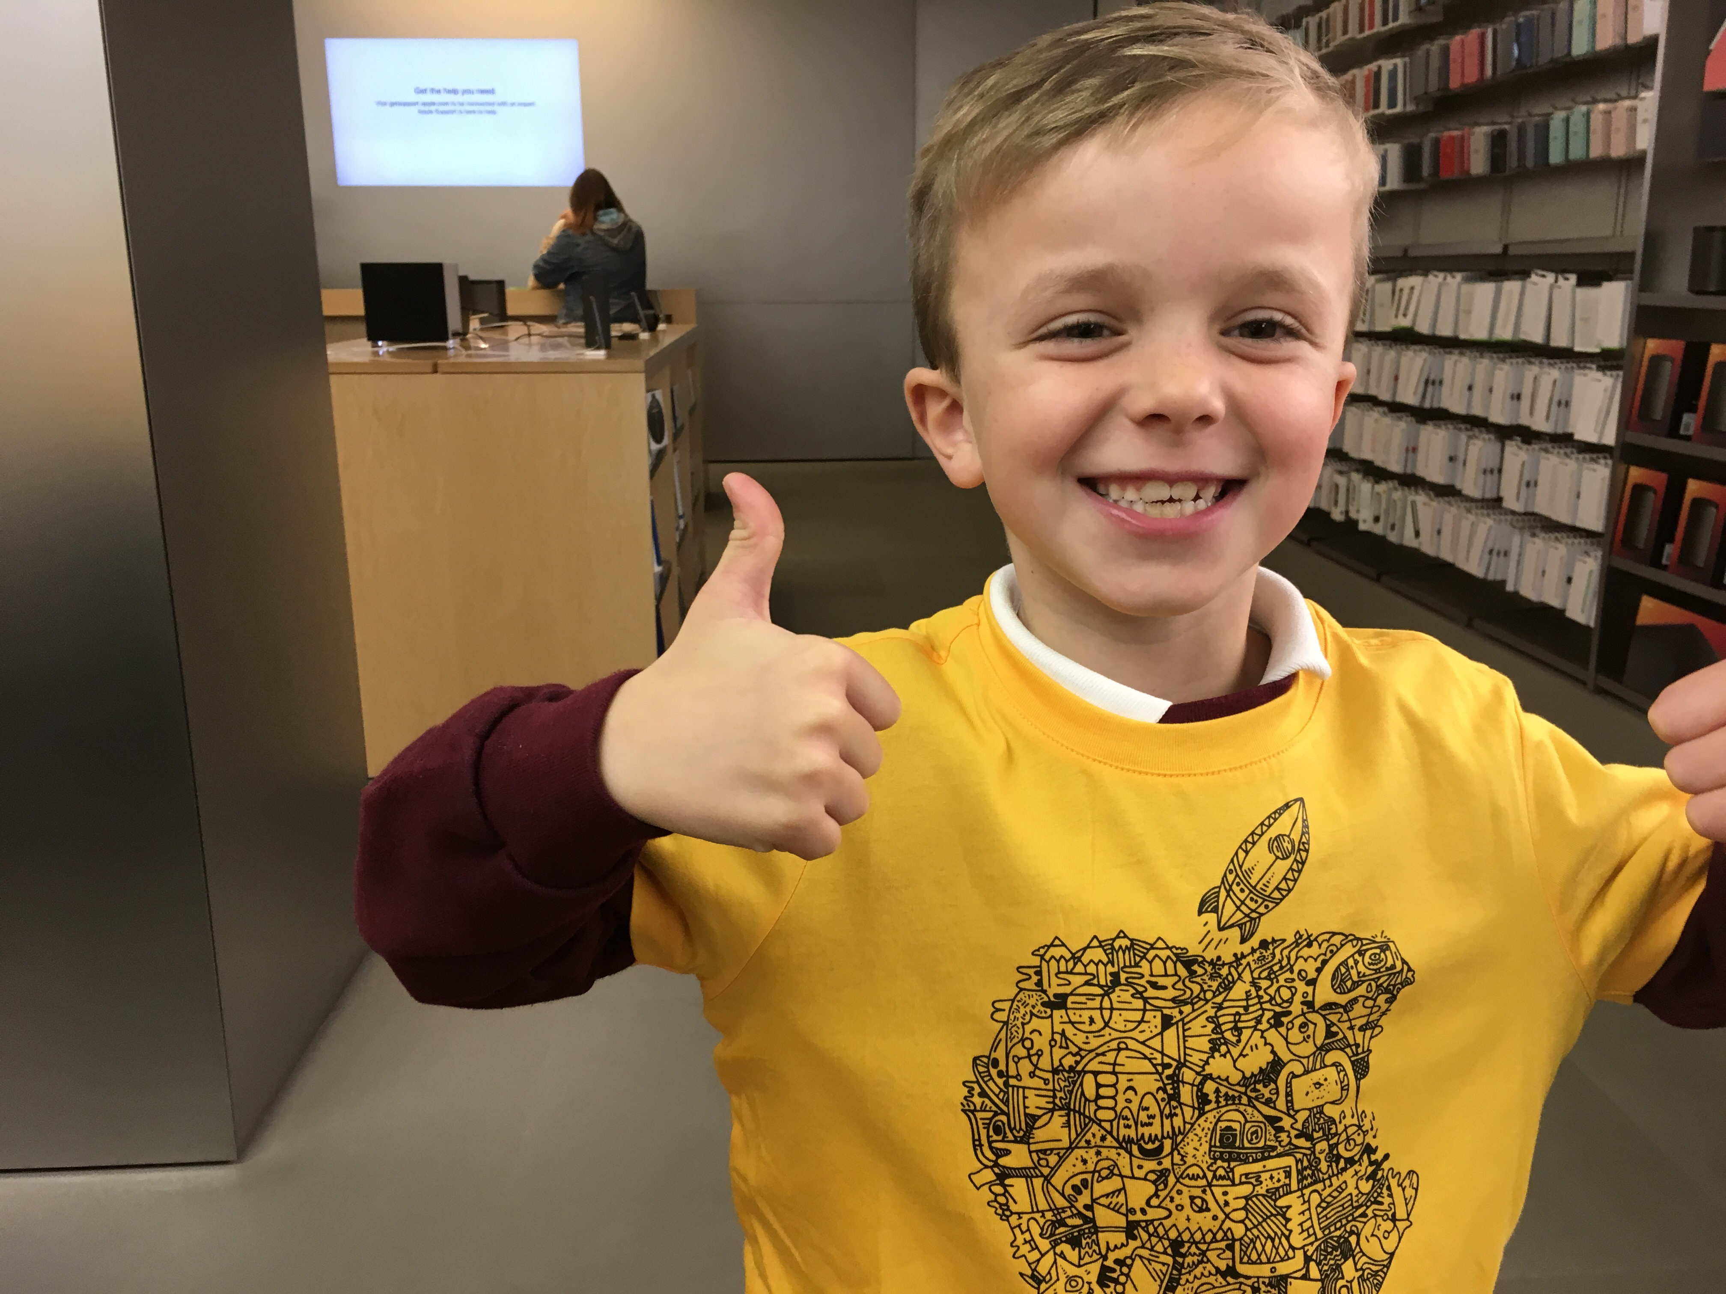
Rudy's Favourite friends
Are Finlay and George

Slide 7
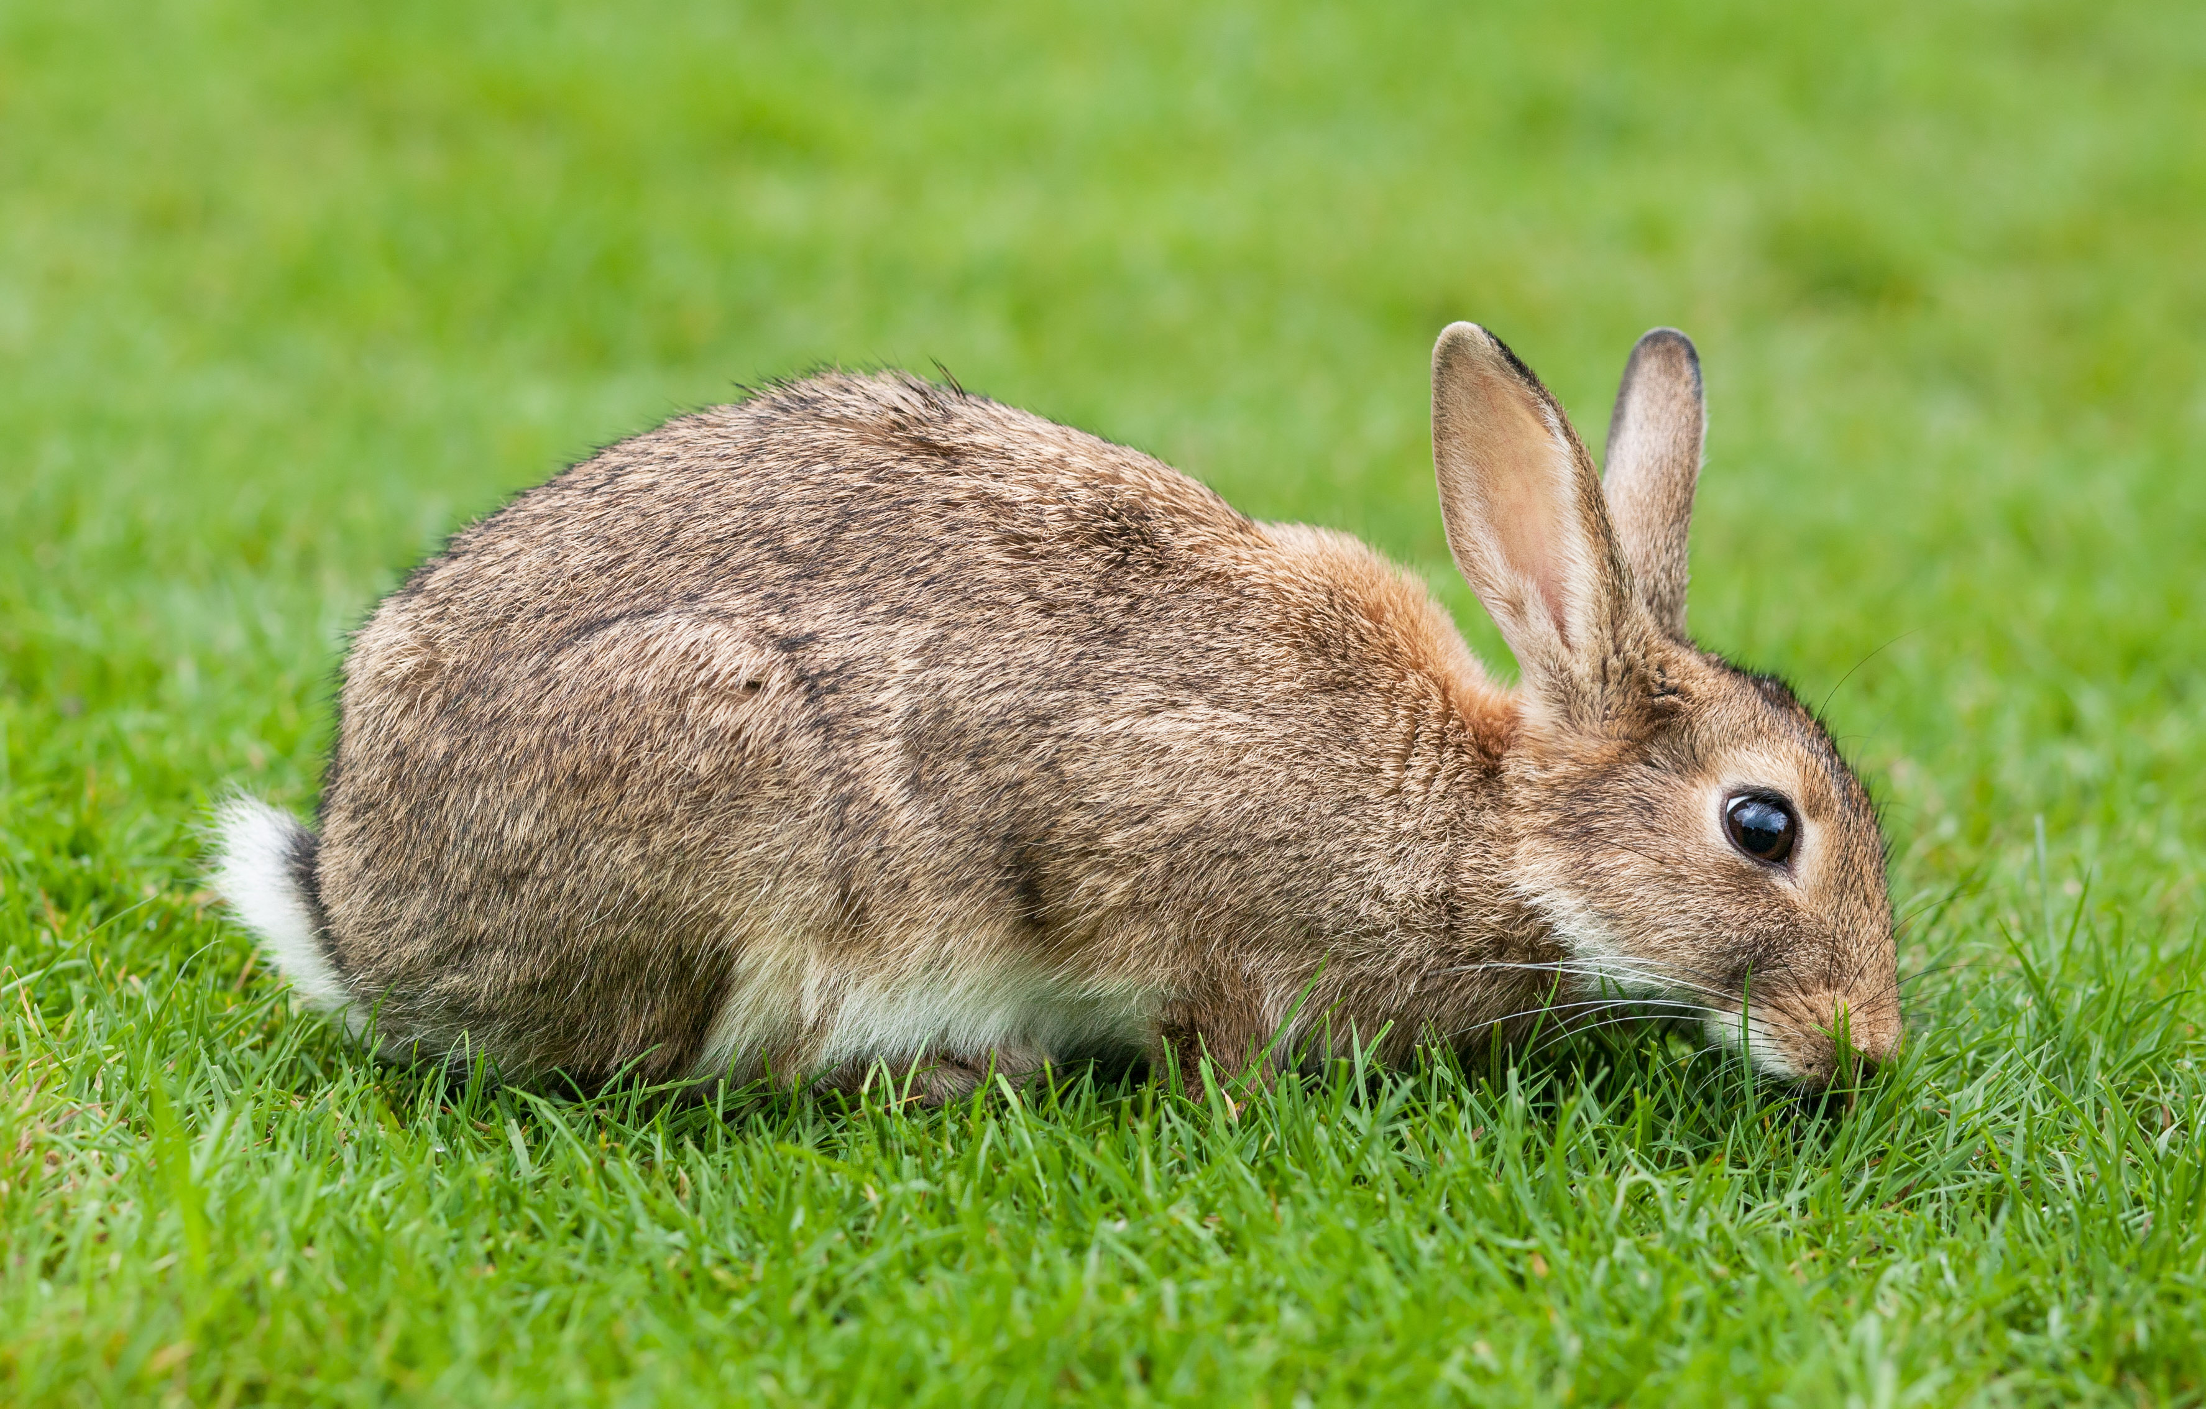
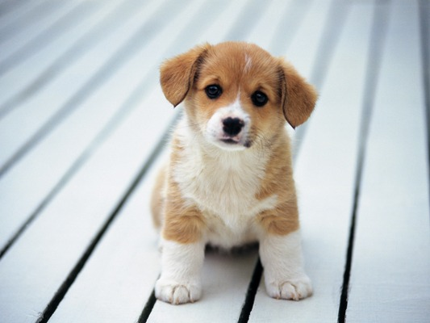
Rudy's Favourite pet
Finlay's Favourite pet
Is a rabbit called smokey
Is a puppy

