Slide 1
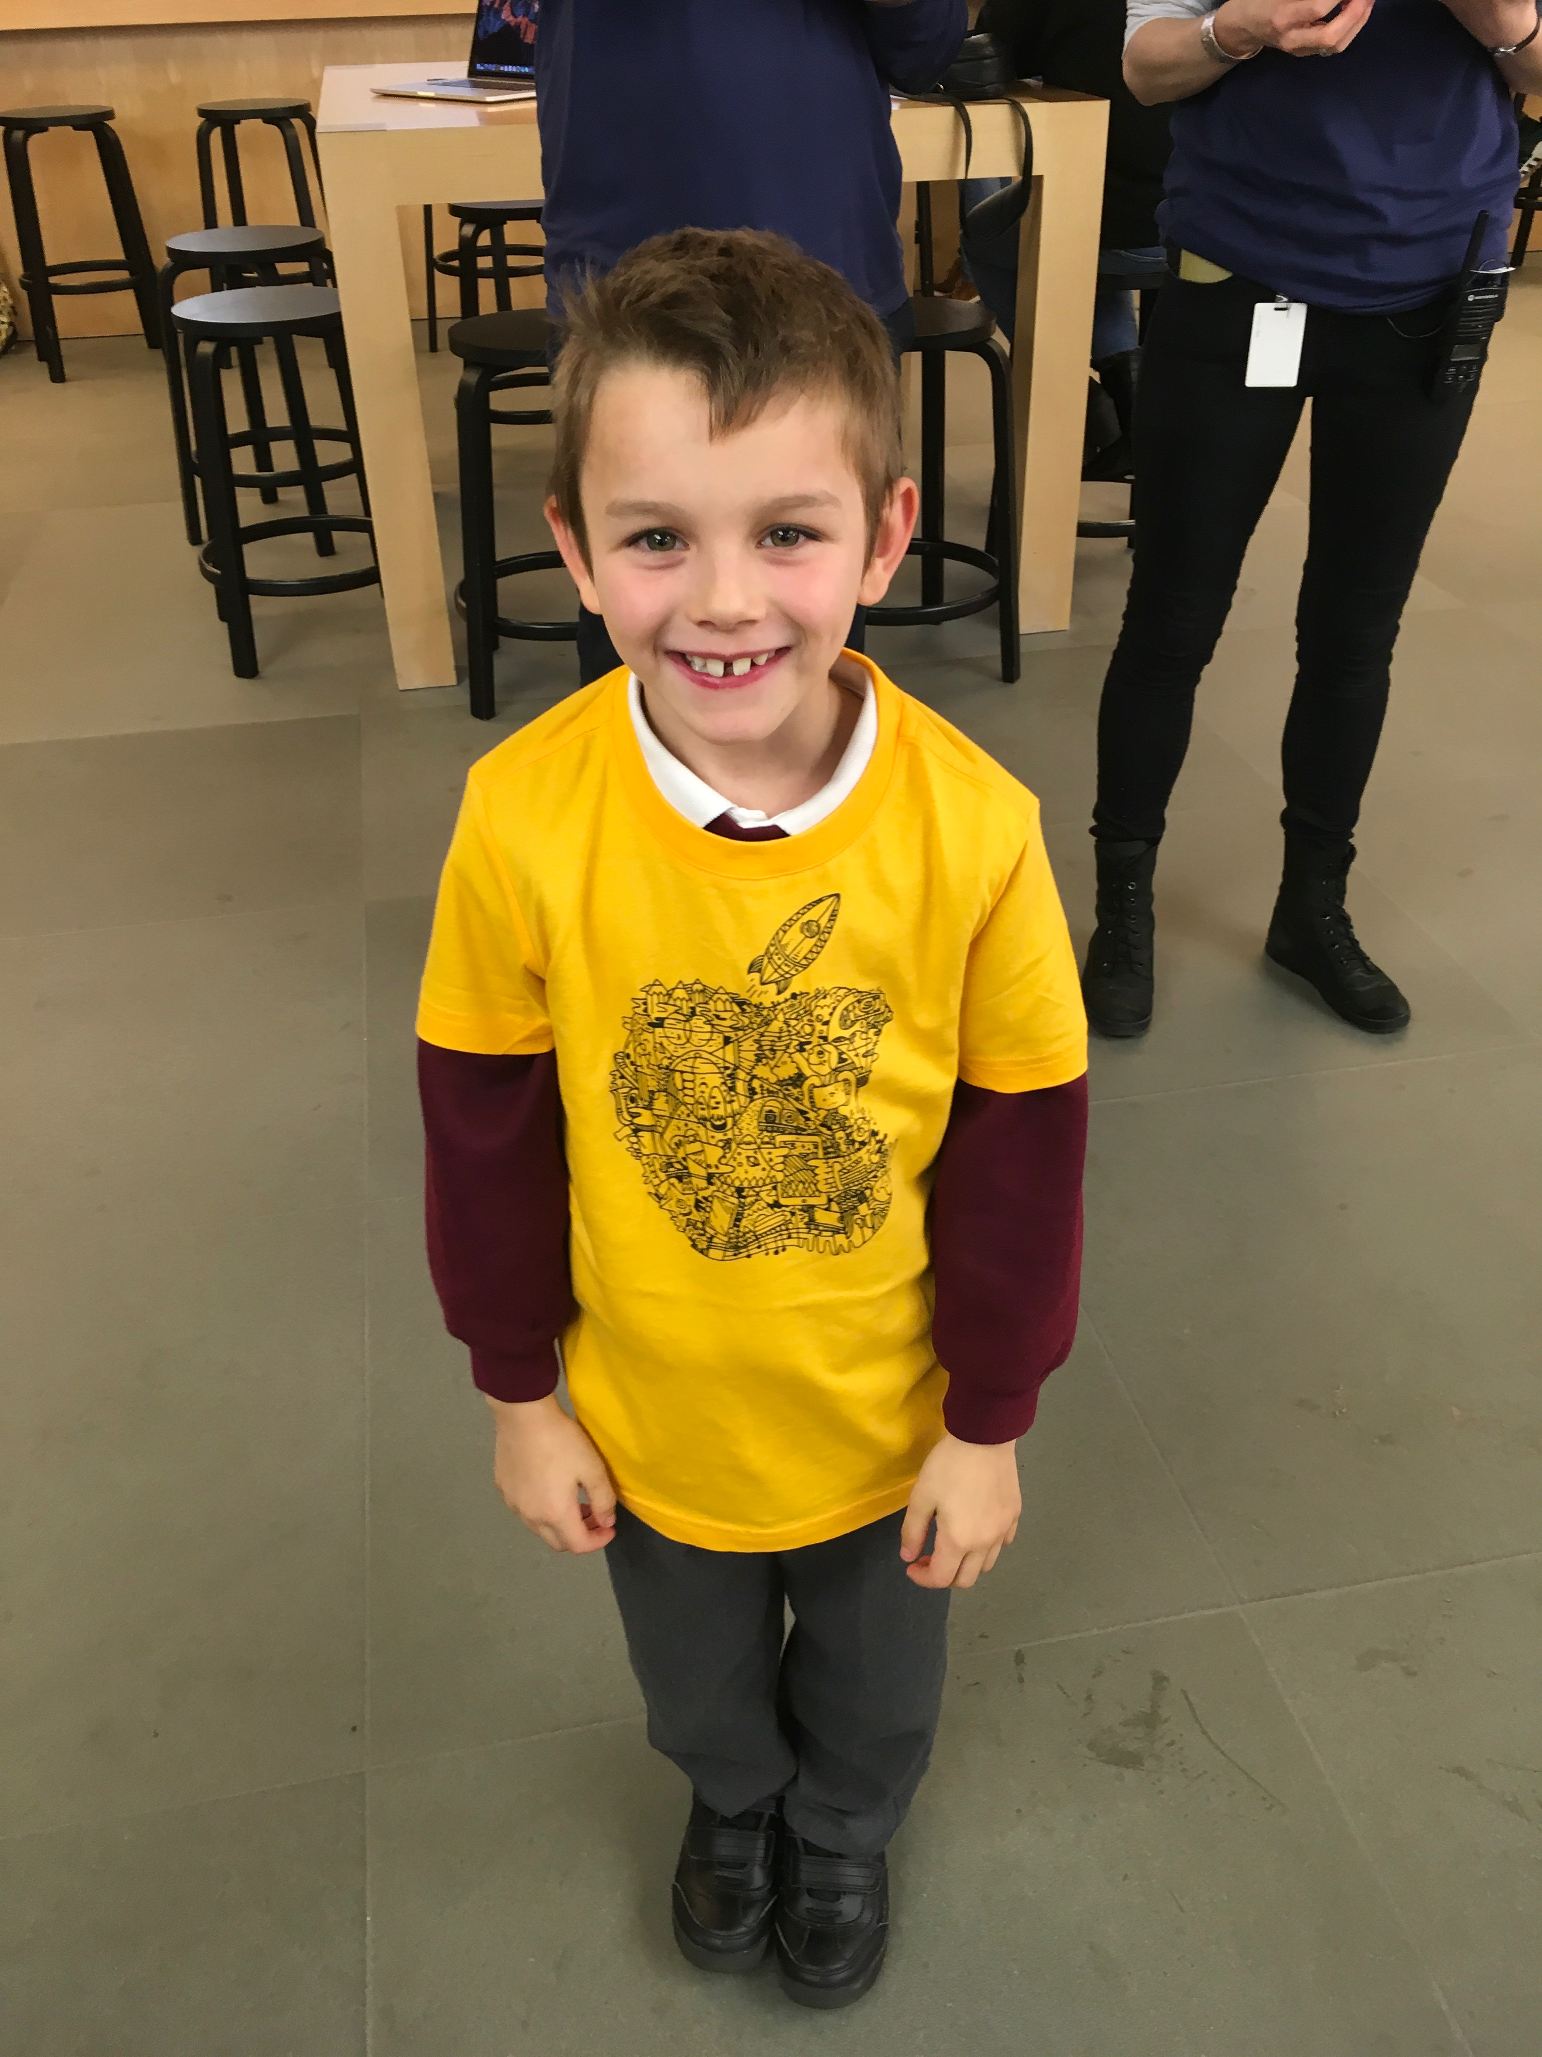
Alekos

Slide 2
My hobbies

Slide 3
My family
Mummy and
Dante and me

Slide 4
The amazing of gumball

Slide 5
Alekos' favourite books
Frank n stan

Slide 6
My funny book big mum plum

Slide 7
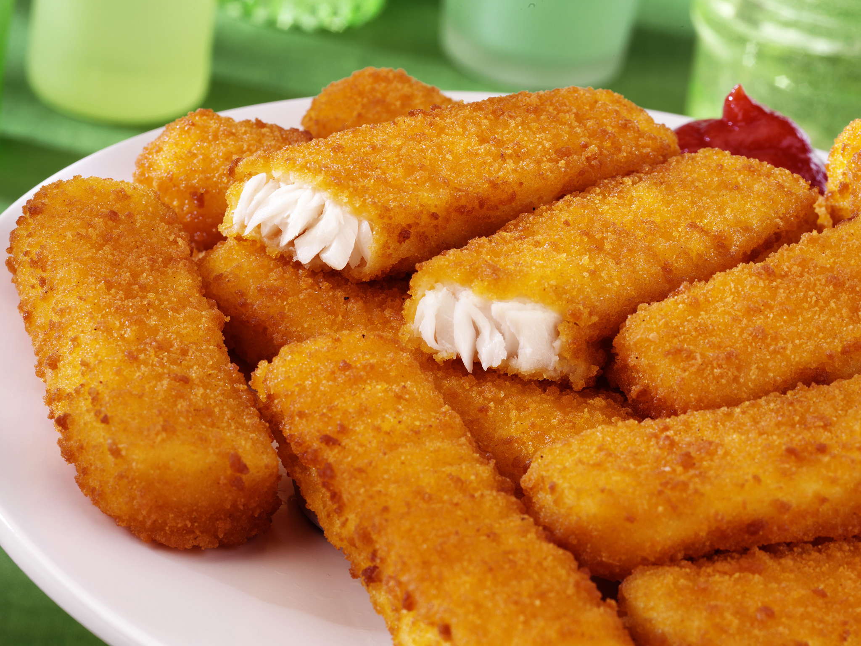
My favourite food

Slide 8
My games

