Slide 1
We have been to France before
Lily Freya

Slide 2
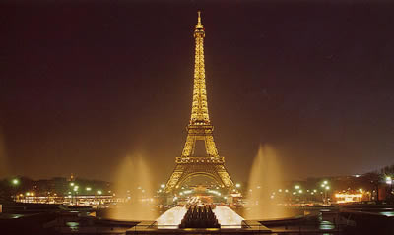
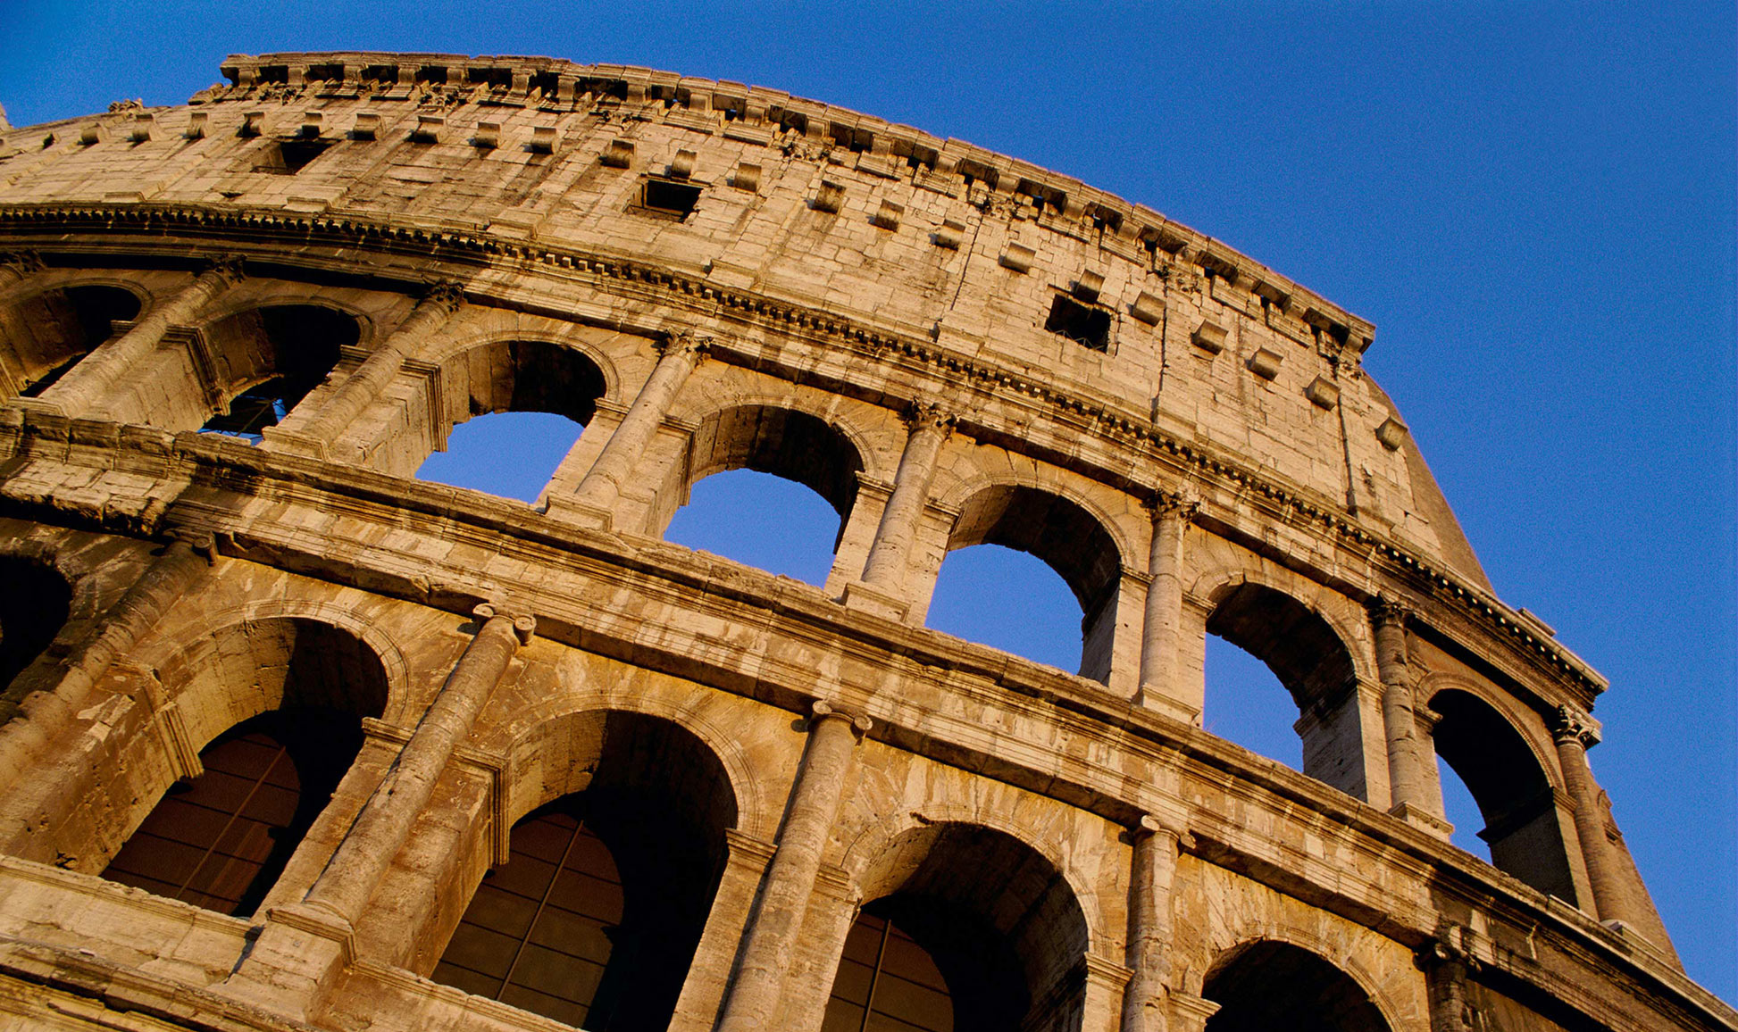
The Eiffel tower In France
🇫🇷 Lily and Freya 🎵🎶✈️🐵🙊🙉

Slide 3
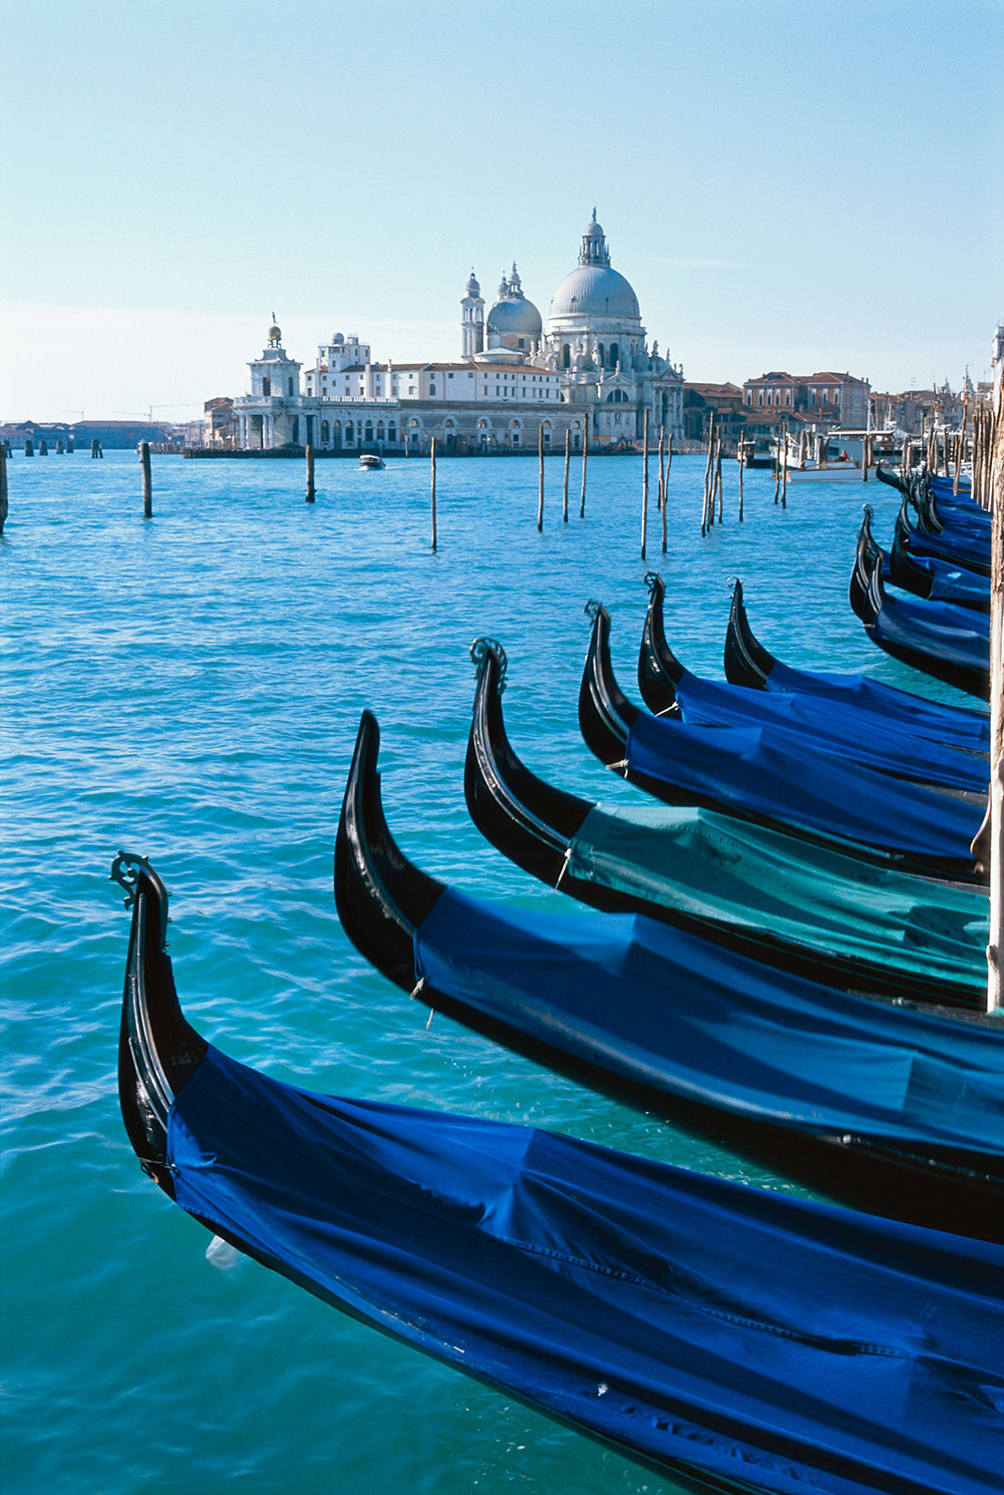
Lily
When I went to menorca I went to a fancie dinner with my family and a stroll along the beach it was fun and then we went on a boat ride that was awesome

Slide 4
Hello I am Freya
Hi I went to Greece and I went in August and we came back in august and we came back on the 15th of August I had a fun time it was cool

