Slide 1
Iceland
This is were I want to go
I want to se all the different sites .

Slide 2
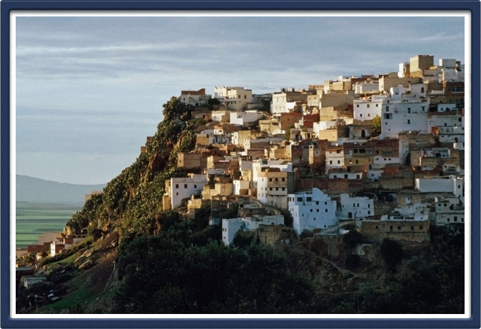
Italy
I want to go here because I want to taste the different foods.

Slide 3
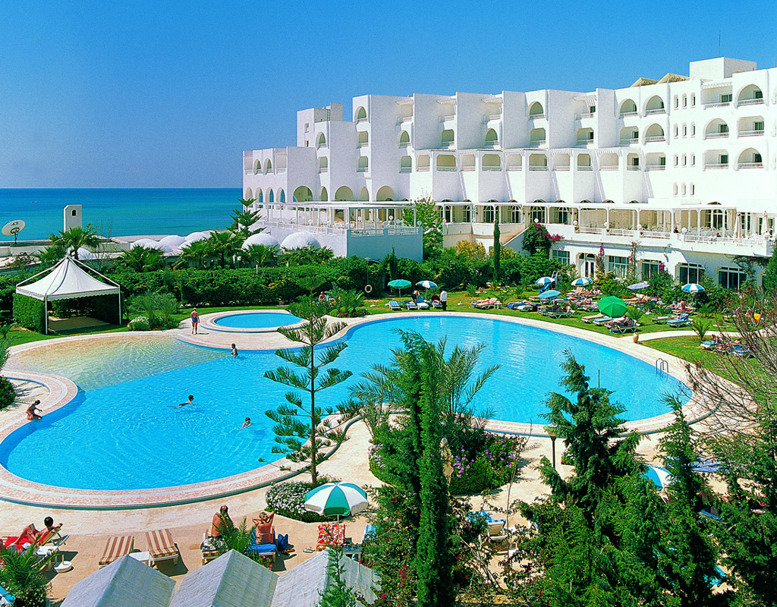
This is going to be my next Holiday with my cousins.

Slide 4
I want to go to Poland because my dad used to work here.

Slide 5
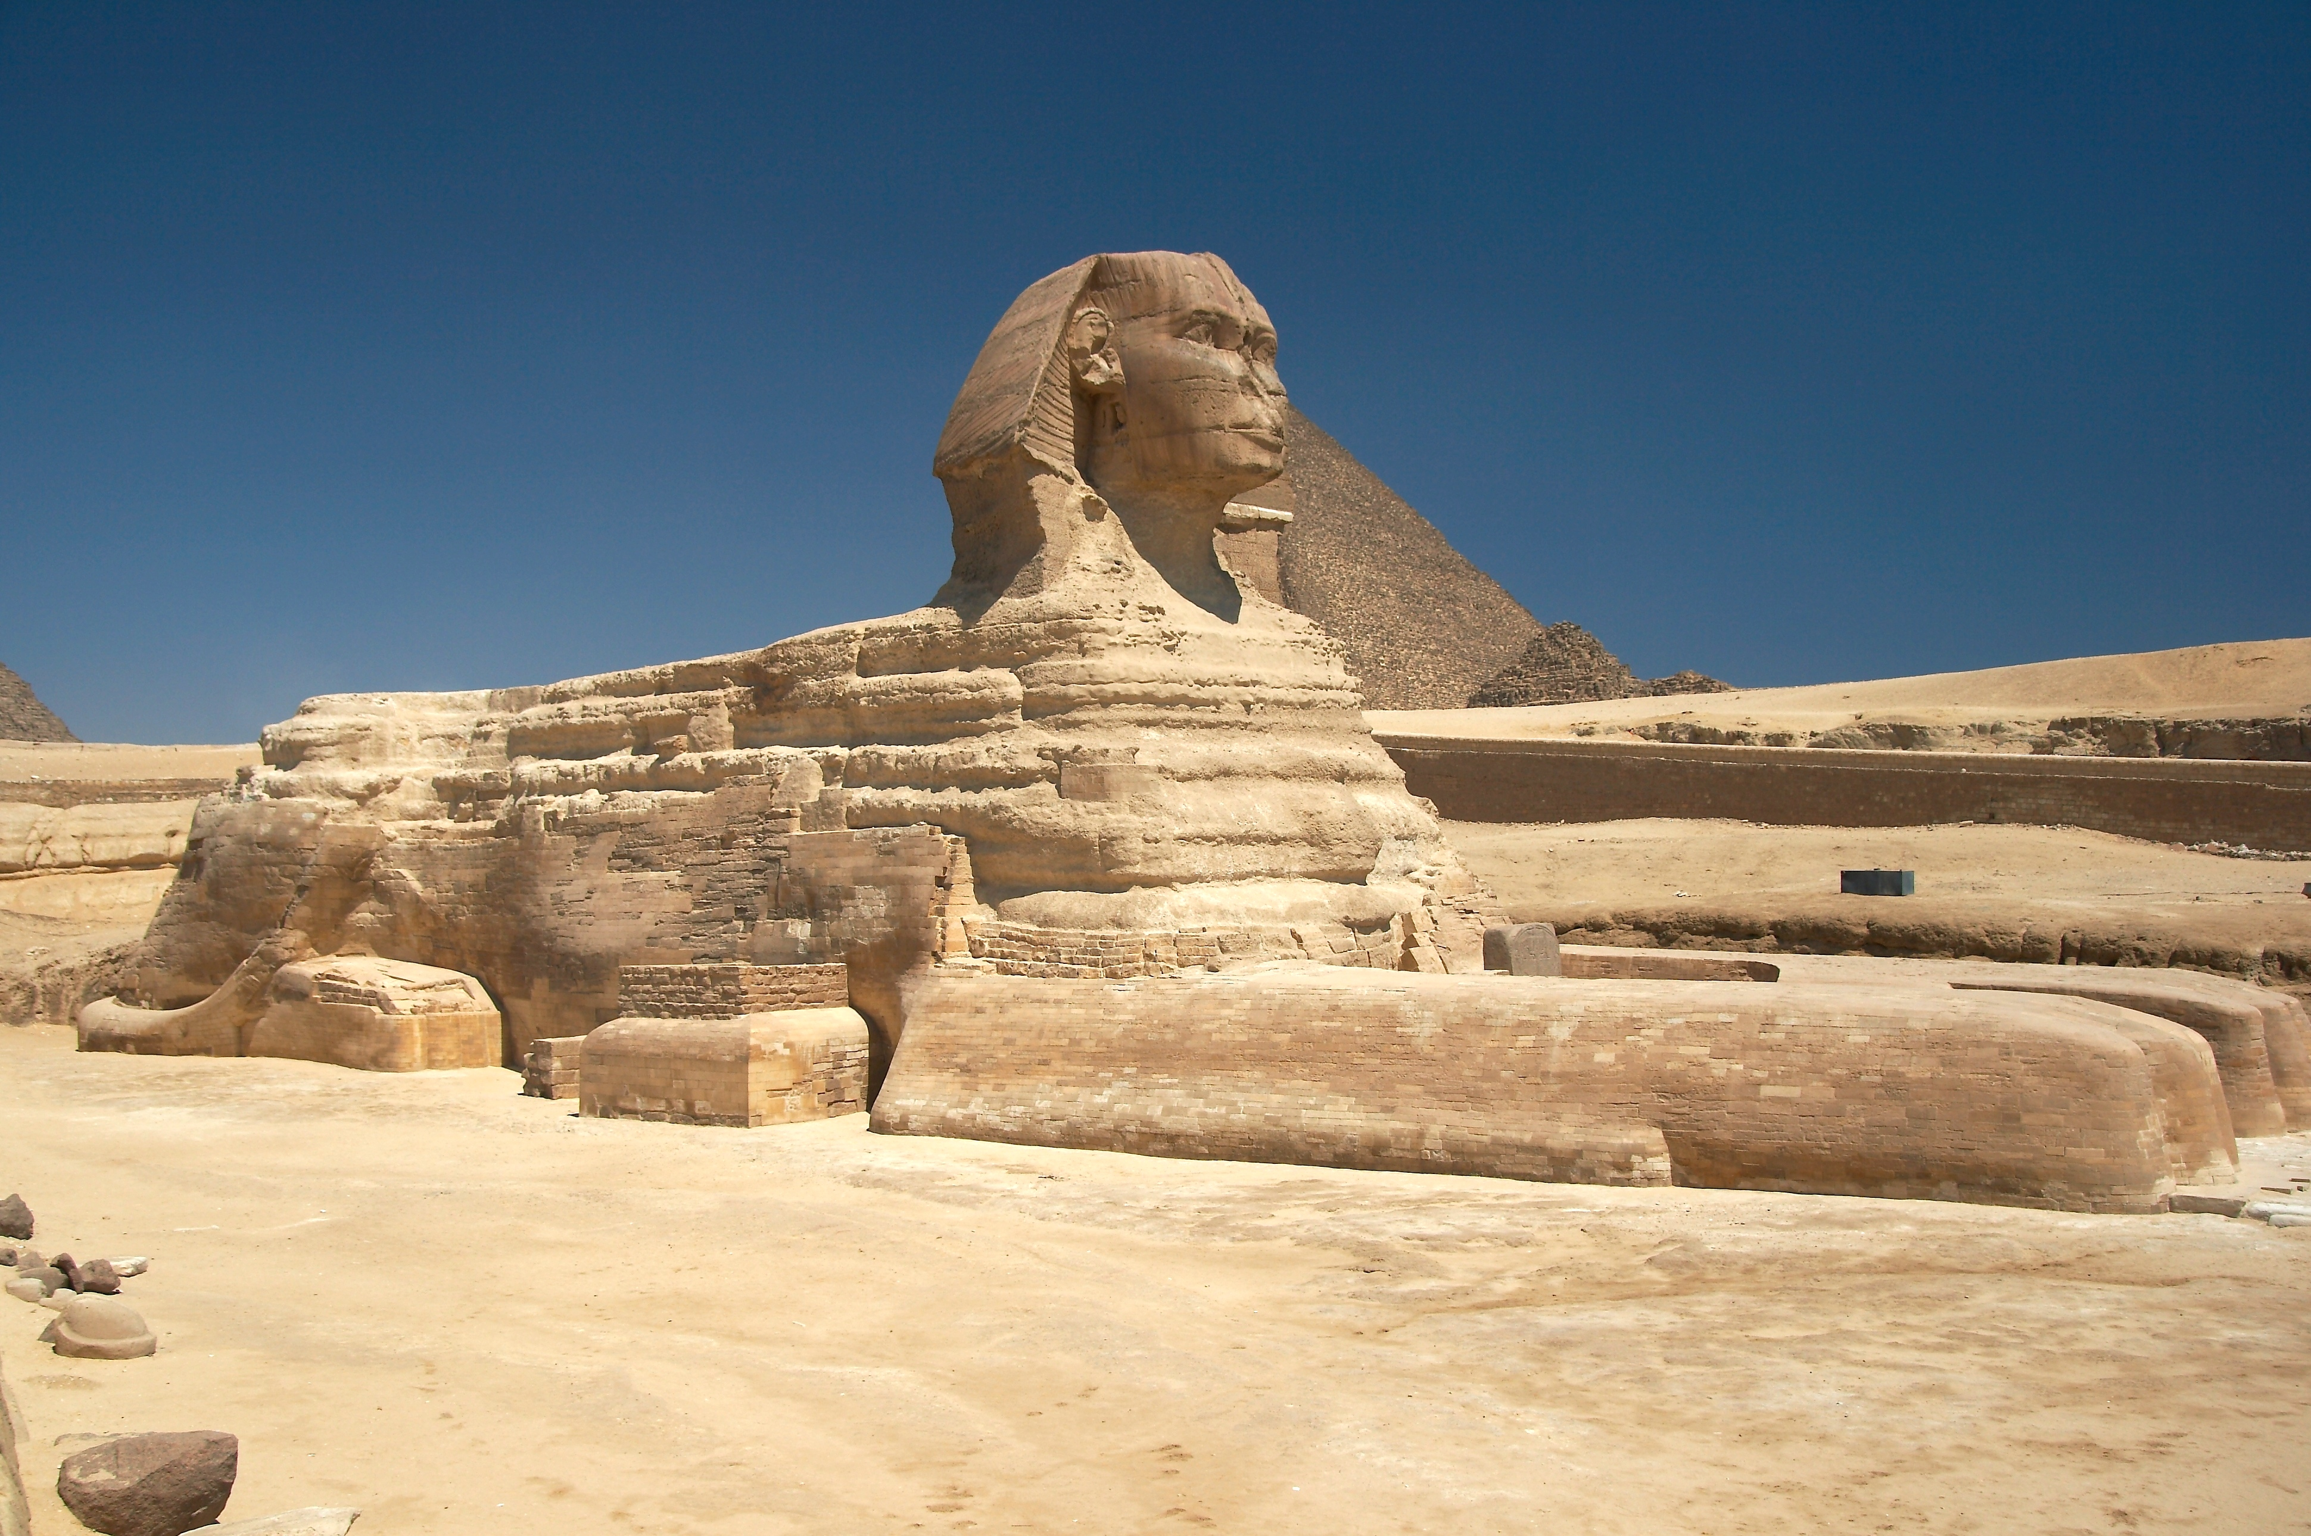

Slide 6
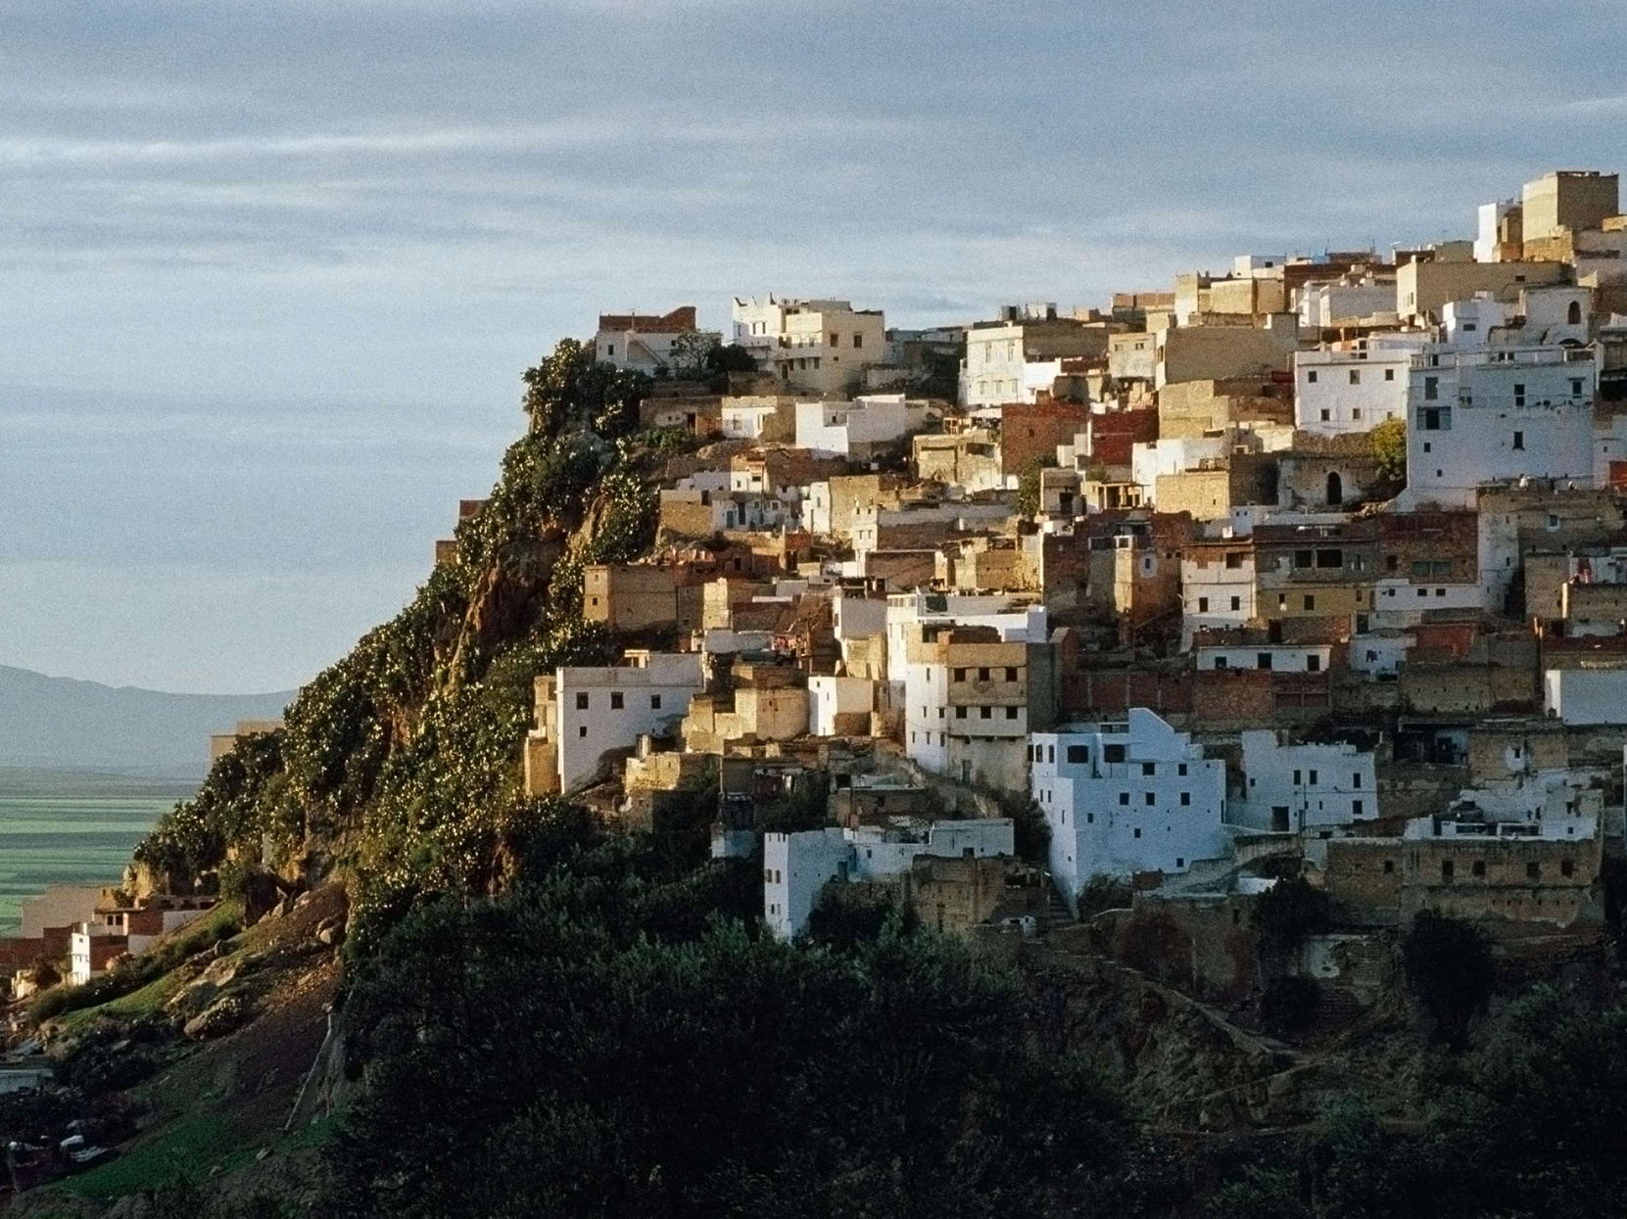
In France I went to a campsite that had an indor and outdoor swimming pool.

Slide 7
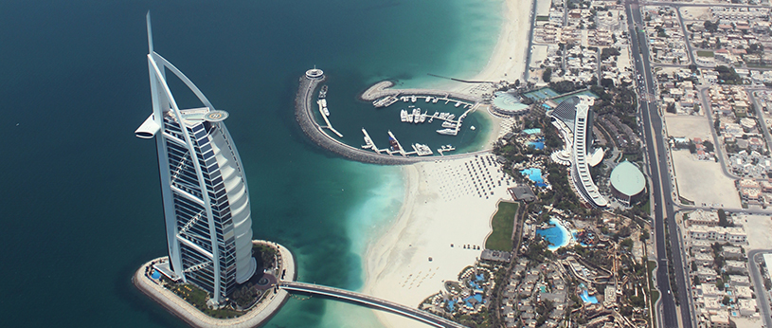
This is were I went for on e of my hoildays

